Slide 1
Verso un trasporto marittimo pulito nel Mediterraneo Blue District, October 27
A sea of smoke
Enzo Tortello
Ecoistituto di Reggio Emilia e Genova President
Comitato Tutela Ambientale Genova Centro-Ovest President

Slide 2
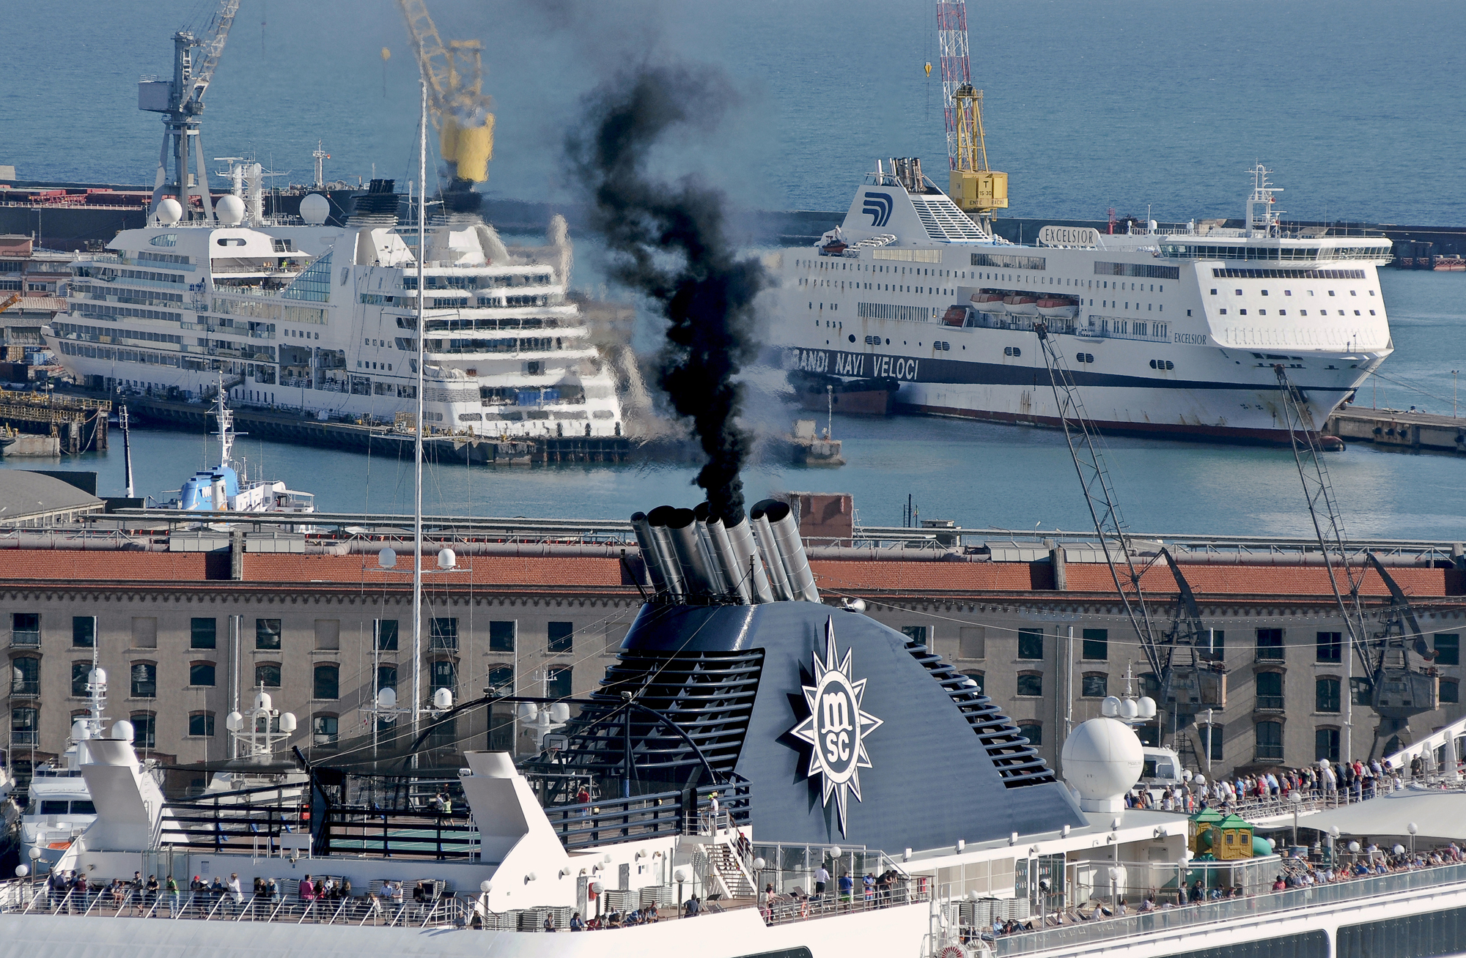
Verso un trasporto marittimo pulito nel Mediterraneo Blue District, October 27

Slide 3
Verso un trasporto marittimo pulito nel Mediterraneo Blue District, October 27
Item 1
Generally speaking, NOx emissions from ships are checked, by indirect way, verifying if ship certificates are compliant with international standards. Direct traditional tests made at the ship chimneys are very costly, invasive, and time consuming. We suggest controlling emissions within the port’s area utilising drones equipped with electronic “nose” and/or visual sensors.

Slide 4
Verso un trasporto marittimo pulito nel Mediterraneo Blue District, October 27
Item 2
Some regions (North Seas, Canadian and USA coasts) are identified as certified Emission Control Areas (ECAs). That means that both NOx and SOx are closely checked and verified so that emissions are kept within very strict limits. We suggest that also all Mediterranean ports are monitored, set under strict control measures, in order to make all of them ECAs as matter of urgence.

Slide 5
Verso un trasporto marittimo pulito nel Mediterraneo Blue District, October 27
Item 3
It is urgent to implement the necessary infrastructures for setting up everywhere the so-called “cold ironing”. To avoid competition among the different ports, the cost of energy (kWe ) must be aligned in every Mediterranean port. Furthermore, the kWe price should be relieved by additional and local taxes aiming to flat its costs and align them to standard prices, competitive with the ones applied on-board through burning traditional fuels, which produce a continuous, unbearable noise over the neighbourhoods.

Slide 6
Verso un trasporto marittimo pulito nel Mediterraneo Blue District, October 27
Item 4
While waiting for implementing procedures and the legal process towards a generalised Mediterranean certification as ECAs, it is necessary to transform from now the voluntary measures, already adopted by some ports, into general, mandatory measures banning the ships from using fuels with Sulphur higher than a maximum of 0.1%, when approaching 12 miles far from the port. At the same time, immediate incentives must be approved for putting in place the de-NOx systems progressively in all the existing old ships.

Slide 7
Verso un trasporto marittimo pulito nel Mediterraneo Blue District, October 27
Item 5
It is also the right time to adopt a generalised, international measure for defining the maximum and acceptable “life” for all ships (i.e. 25 or 30 years). When older than this service period, ships must be banned from all ports, because they are not suitable and put at risk the population with air pollution and noise. For that, incentives must be planned.
.

Slide 8
Verso un trasporto marittimo pulito nel Mediterraneo Blue District, October 27
ECOISTITUTO CITIZEN SCIENCE
Integration of ARPAL monitoring net with smart sensors directly managed by Citizen and Schoolboys in order to control PM 2.5/PM 10 and NOx emissions

Slide 9
Verso un trasporto marittimo pulito nel Mediterraneo Blue District, October 27

Slide 10
Verso un trasporto marittimo pulito nel Mediterraneo Blue District, October 27
Thank you !

