Slide 1
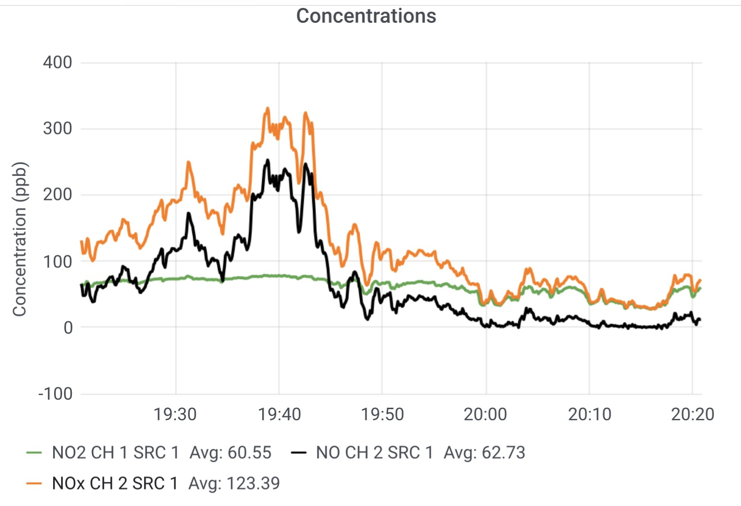
N02 and NO Concentrations in Civitavecchia

Slide 2
NO2 and NO Concentrations in Civitavecchia Port

