Slide 1



Le Aree ECAs in Europa del Nord, impatto e prospettive
Kare Press-Kristensen
M.Sc. in engineering, Ph.D.
Senior advisor on air quality
Green Transition Denmark
kaare@rgo.dk

Slide 2

Health effects of air pollution in Italy
Around 65,000 people die from air pollution every year in Italy (EEA, 2020). That is 10.5% of all deaths (630,000).
In 2020+2021 air pollution killed same number of people in Italy as COVID (130,000). No vaccine against pollution.
Best estimate: 8,000 ± 4,000 people in Italy die due to air pollution from shipping every year.
Diseases: Cardiovascular and airway diseases, cancer, etc.
It is very cost effective to reduce air pollution from ships.

Slide 3
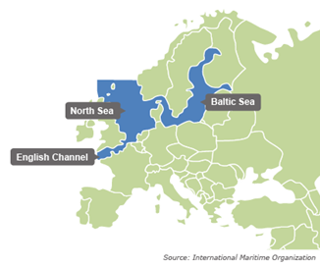
Emission control area in Northern Europe
SOx Emission Control Area from 2007 with the strictest sulphur limit from 2015.
NOx Emission Control Area from 2021 for all new build ships.

Slide 4
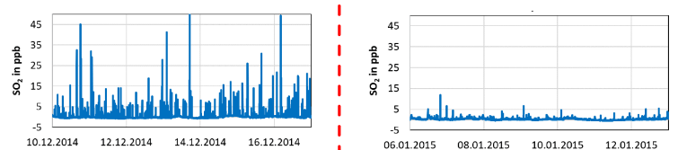
Measurements from Northern Europe
Before SECA
After SECA
Measurements from Neuwerk (German island)
Concentrations of toxic SO₂ immediately dropped, as expected, after introducing the SECA

Slide 5
Conclusions from Northern European ECA
Plenty of distillate fuel (0.1% sulphur) available.
High reduction in sulphur on land (50% drop in 2015).
Significant health and economic benefits for society.
No enforcement challenges (0.0067% violations).
No cargo transfer from ship to road.
No notable price increases for consumers (< 0.005%).
No notable extra costs for ship owners or authorities.

Slide 6
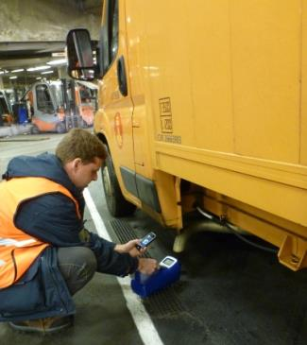
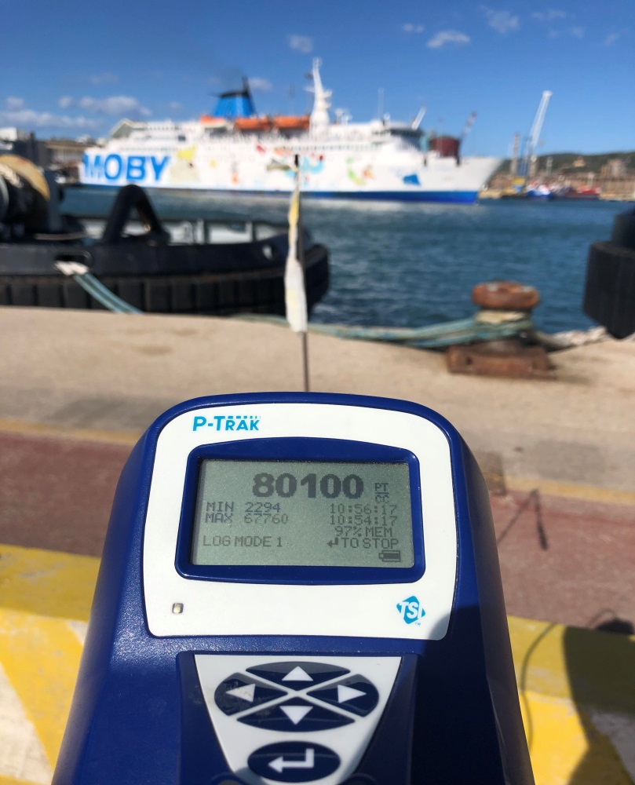
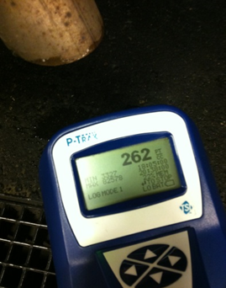
All newer road vehicles have filters
Ships have no filters. A cruise ship (4,000 p.) at berth emits as many particles as 5,500 cars per second.
Piombino
Oct. 6th, 2021
Wind: 6-8 m/s.

Slide 7
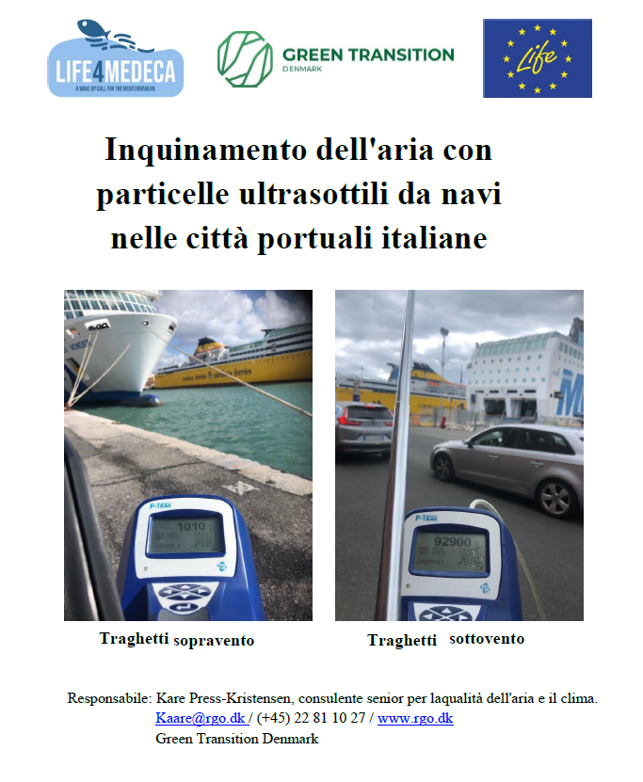
Measuring report
Report with screening measurements from Italian port cities:
https://rgo.dk/wp-content/uploads/LIFE4MEDECA_Air-pollution-from-shipping-in-Italian-ports_IT.pdf

Slide 8
Solutions for ship pollution
In ports:
Shore power for cruise ships, ferries, cargo ships, etc.
At sea:
Electric ferries – Great potential.
Particulate filters for ships (removes > 95%).
Emission Control Areas (ECAs) limiting emissions:
- SO₂ emissions will drop 80% immediately.
- NOx emissions will drop 80% over 20-25 years.
- Particle emissions will drop significantly and immediately.

Slide 9
With support from EU: LIFE4MEDECA
This presentation is part of the EU LIFE project: LIFE4MEDECA with the purpose to designate a Mediterranean Sea Emission Control Area to reduce health hazardous and climate damaging emissions of air pollution from ships.

Slide 12
NOx from ships in Northern Europe
Adverse health effects: 42 € per kg NOx emission.
Removal costs: 2 € per kg NOx removed (using SCR).
Society saves around 42 billion € in health damages every time society invests 2 billion € in NOx-removal
→ Rate of return: 2.000% !
+ less damages on crops, constructions, ecosystems, etc.
A NOx ECA is the best investment you can imagine …

Slide 13
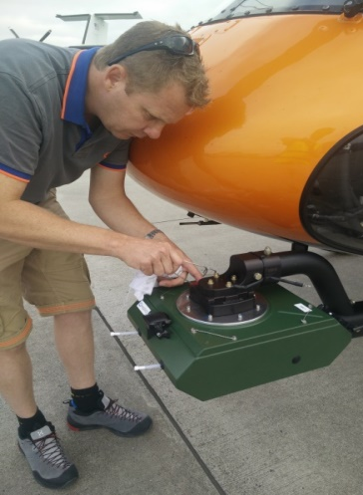
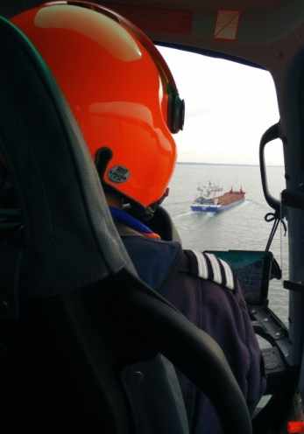
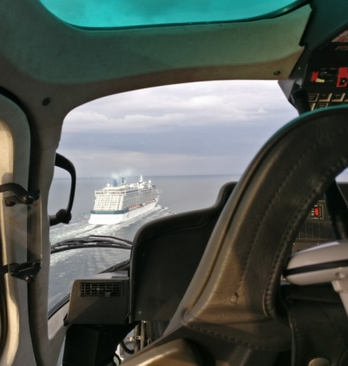
Control and enforcement
EU: - Min. 10% inspections and 4% sulphur analysis.
- Fines must prevent systematic violations.
DK: - Helicopters measuring sulphur, NOx and CO₂ directly in the ship exhaust fan at sea (600/yr.).
- Name and shame on ship/companies violating.

Slide 14
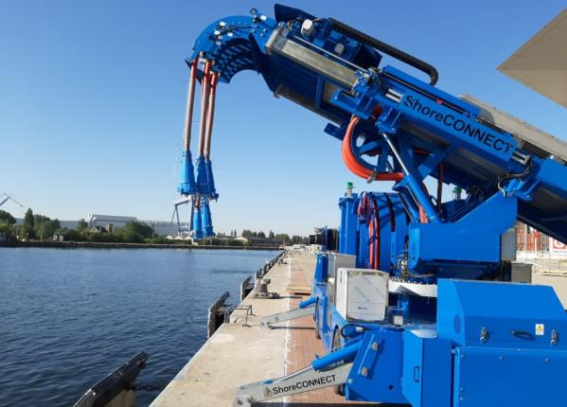
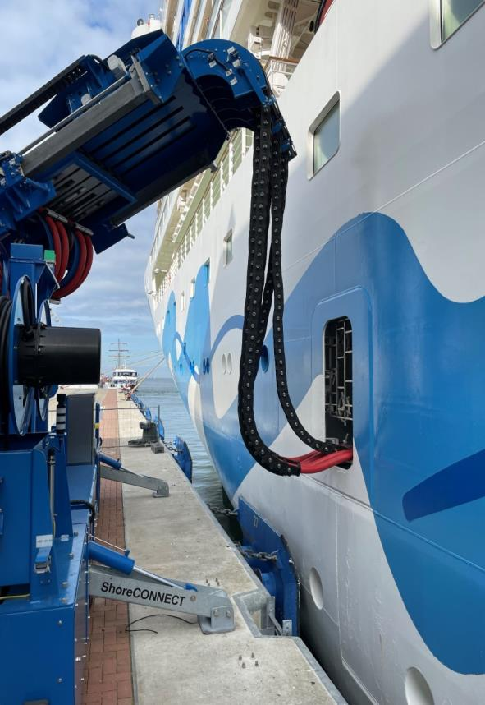
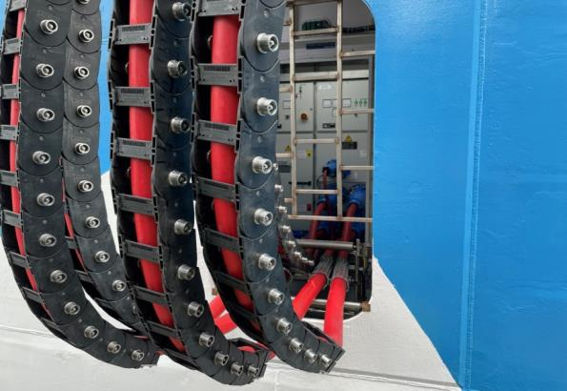
Shore power in Northern Europe

Slide 15
Electric ferries in Denmark

Slide 16
Shipping is poorly regulated
2014: All new trucks in EU have SCR & particulate filters!

