Slide 1
Come NOx e ozono interagiscono negli ambienti portuali
Dr. Axel Friedrich Germany
Verso l’Area ECA Mediterranea
Roma, 22 Giugno 2022

Slide 2
What Are the Health Effects of NO₂?
Nitrogen dioxide causes a range of harmful effects on the lungs, including:
Increased inflammation of the airways;
Worsened cough and wheezing;
Reduced lung function;
Increased asthma attacks; and
Greater likelihood of emergency department and hospital admissions.¹
New research warns that NO₂ is likely to be a cause of asthma in children.²
A large new study found evidence that people with lung cancer faced greater risk from NO₂, Looking beyond the lungs, newer research has linked NO_{2,} ozone, and other outdoor air pollutants. to cardiovascular harm, lower birth weight in newborns and increased risk of premature death.⁴
https://www.lung.org/clean-air/outdoors/what-makes-air-unhealthy/nitrogen-dioxide

Slide 3
Environmental Impact of NO_{x}
NOx molecules react with volatile organic compounds (VOC) and form under sunlight and higher temperature ground-level (or tropospheric) ozone (O₃).
Ozone at the ground level is a serious pollutant. Ozone in addition to the health impact, damage plants and materials like cotton.
NOX contribute to acid rain and nutrification of soil. It also
Additionally NOx deposion into water provides algaes with attitional nutrients and leads to algal blooms.

Slide 4
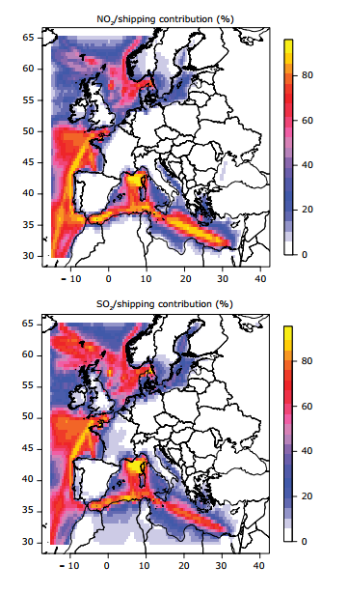
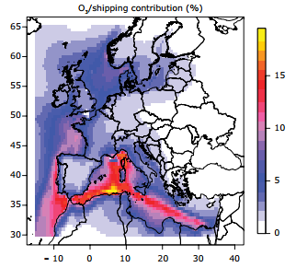
Maps of Contribution of Shipping Emissions in % to the Annual mean of NO2, SO2, PM2.5 and Av. of the Summer daily max O3
Source: EEA 2013

Slide 5
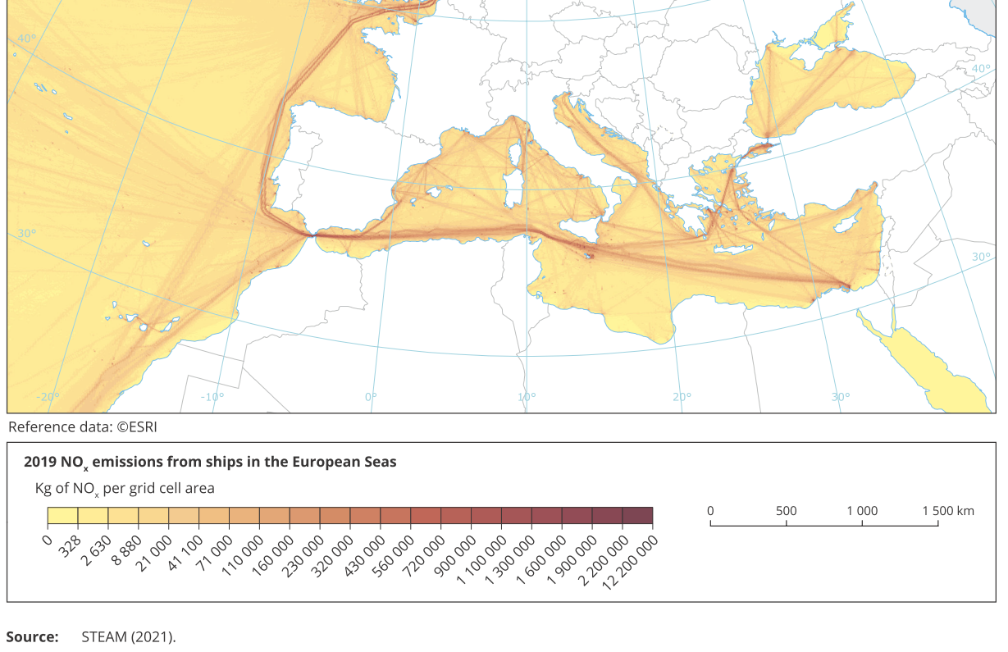
NOx Emissions from Shipping in the Mediterean Sea

Slide 6
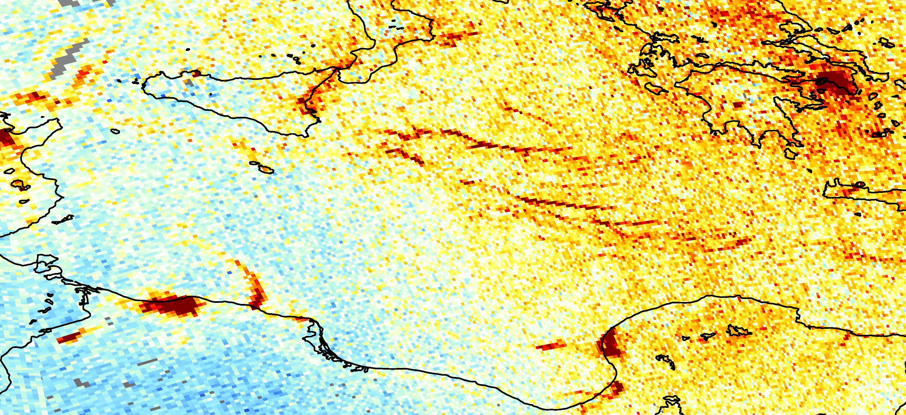
https://www.esa.int/ESA_Multimedia/Images/2020/11/Nitrogen_dioxide_emissions_over_the_Mediterranean

Slide 7
EU Air Quality Directive 2008/50/EC
Pollutant | Concentration | Averaging period | Legal nature | Permitted exceedences each year
Fine particles (PM2.5) | 25 µg/m3*** | 1 year | Target value entered into force 1.1.2010 Limit value enters into force 1.1.2015 | n/a
Nitrogen dioxide (NO2) | 200 µg/m3 | 1 hour | Limit value entered into force 1.1.2010 | 18
 | 40 µg/m3 | 1 year | Limit value entered into force 1.1.2010* | n/a
PM10 | 50 µg/m3 | 24 hours | Limit value entered into force 1.1.2005** | 35
 | 40 µg/m3 | 1 year | Limit value entered into force 1.1.2005** | n/a

Slide 8
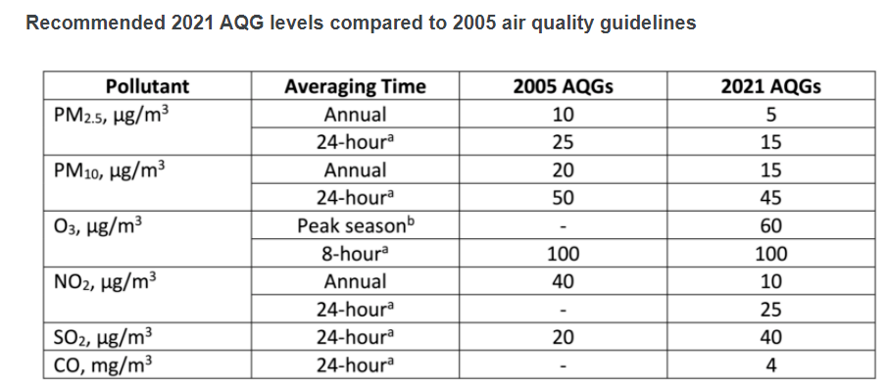
WHO Air Quality Guidelines

Slide 9
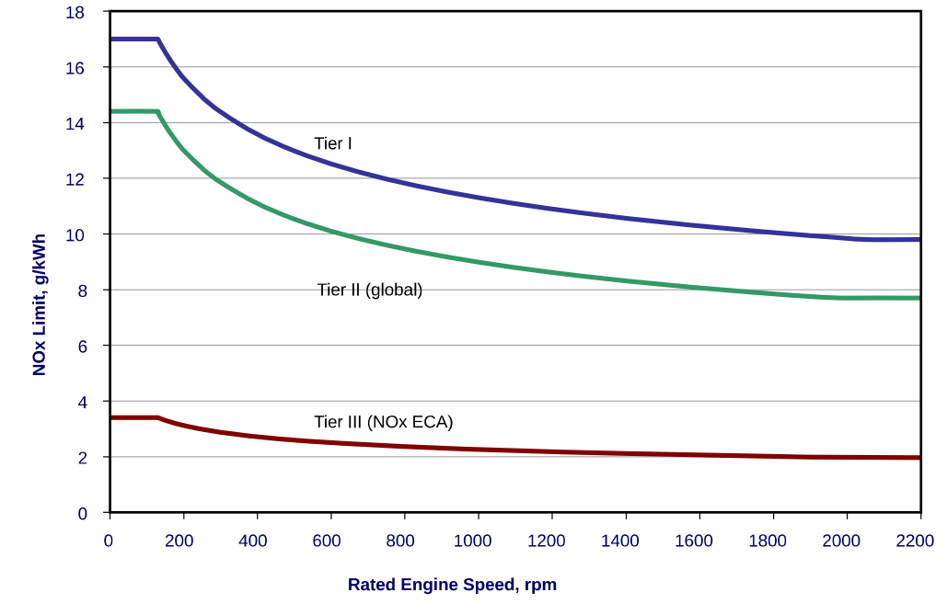
Marpol Annex VI NO_{x} Emission Limits
Emission Limits HDV EU Euro VI: 0,4g/kWh Nox
0,01 g/kWh particles
8,0*10¹¹ particle number
Sea ships: No limits
https://dieselnet.com/standards/inter/imo.php

Slide 10
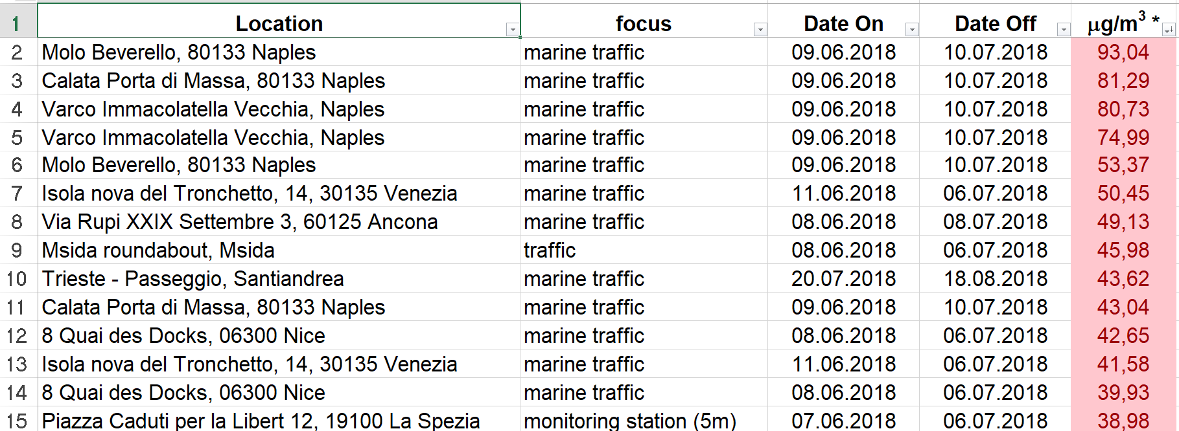
NO₂ Measurement with Passive Sampler

Slide 11
Conclusion
Mediterranean Sea
The evidence of the air pollution level of NO, NO2, Ozone and particles show the urgent need to introduce not only a SECA, but also a NECA and a PECA in the Mediterranean Sea.
Analyses from research groups like IASSA and INERIS show that the benefit is much higher than the abatement cost

Slide 12
axel.friedrich.berlin@gmail.com
Notes:
12
12
12
12

Slide 13
