Slide 1

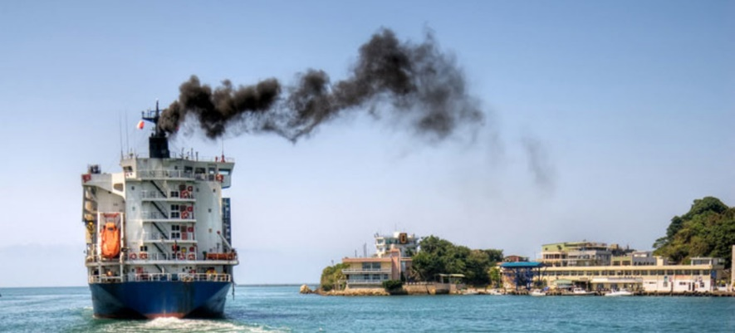

Efficiency and renewable energy exploitation in shipping
Alessandro Iafrati
Consiglio Nazionale delle Ricerche – Istituto di Ingegneria del Mare
alessandro.iafrati@cnr.it
CLIMATE CHANGE
Shipping emits approximately 1 billion tons of CO2. Emissions are projected to increase by
20–50% between 2008–2050. Ships entering EU ports emit 13% of the total EU transport emissions
AIR POLLUTION
Current use of Heavy Fuel Oil pollutes air in port cities with Sulphur dioxide, Nitrogen oxide, particulate matter, and creates harmful effects on environment and human health
Credits: www.shippingitaly.it
Credits: www.waterborne.eu

Slide 2
Zero Emission Waterborne Transport Partnership
Strategic Research & Innovation Agenda
Credits: www.waterborne.eu

Slide 3
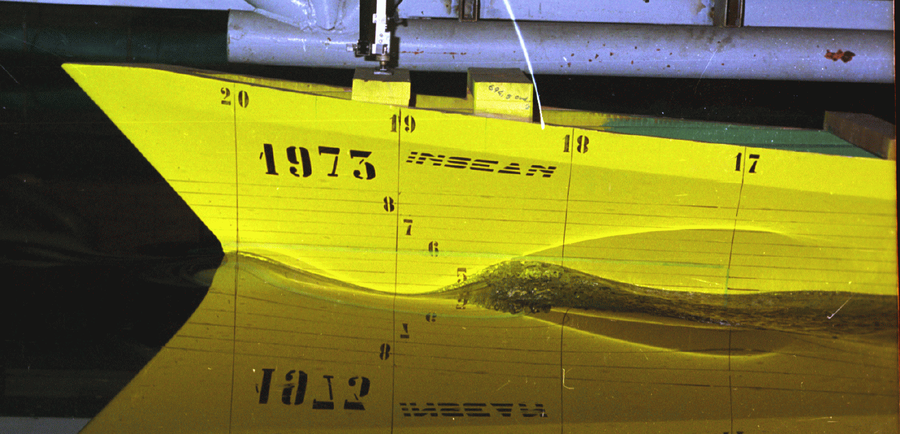
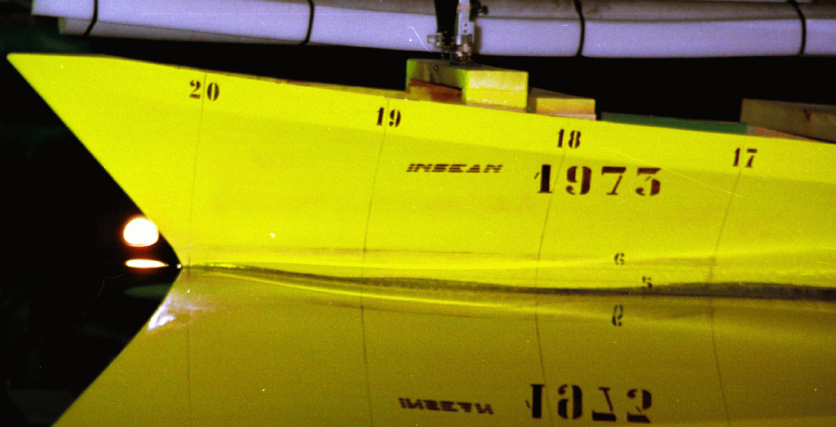
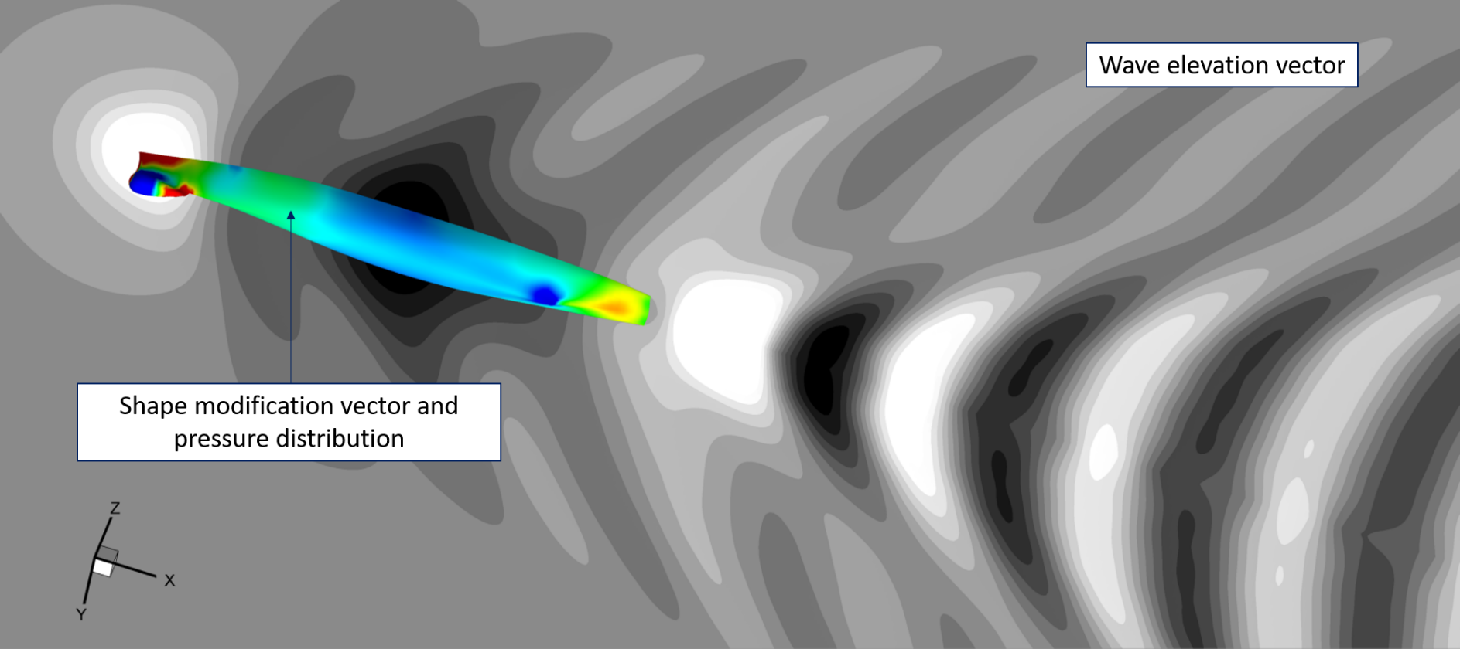
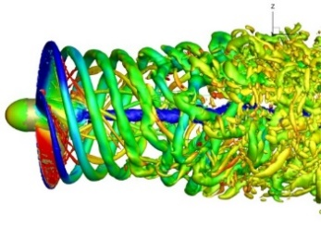
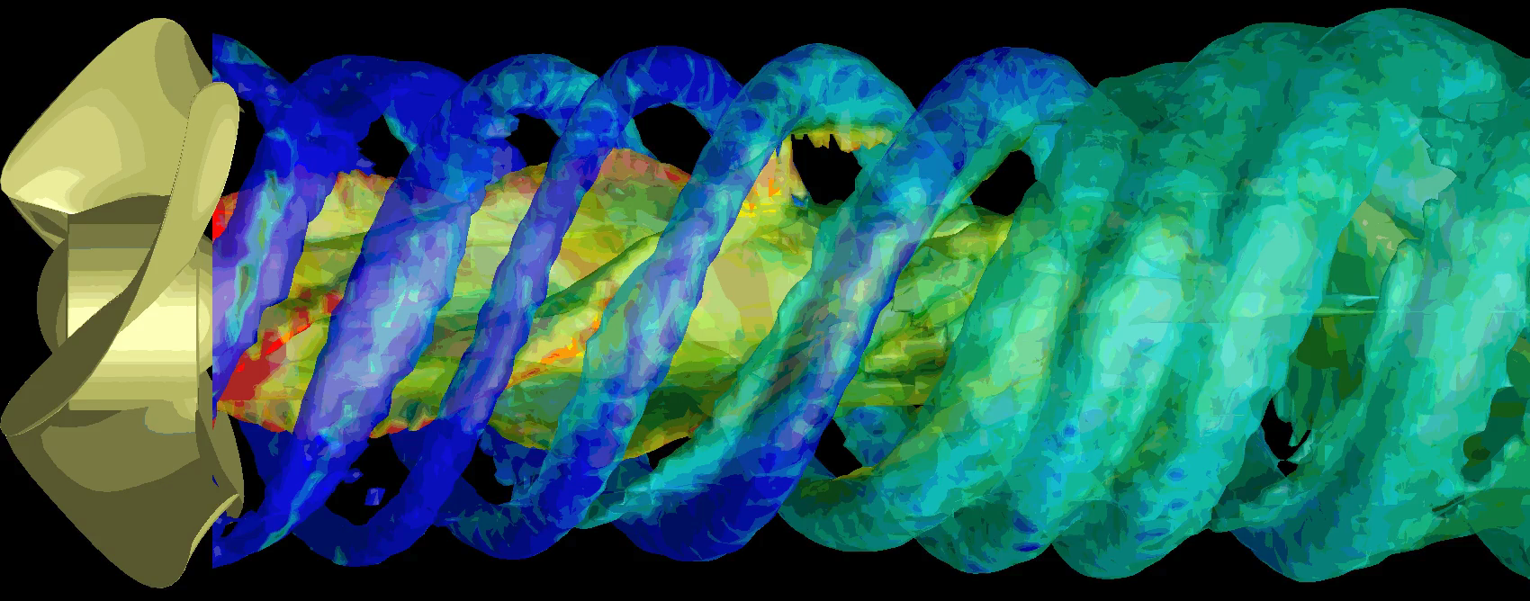
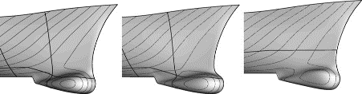
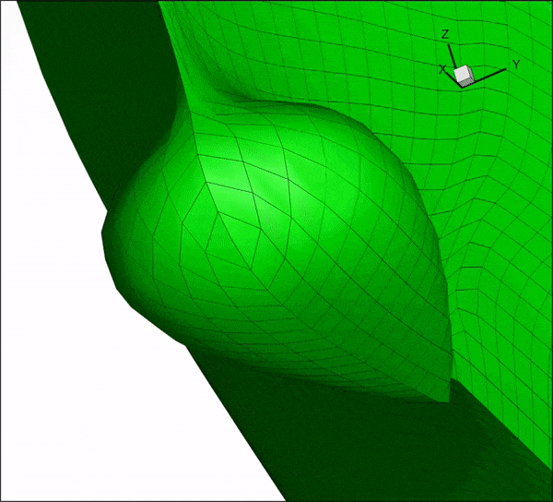
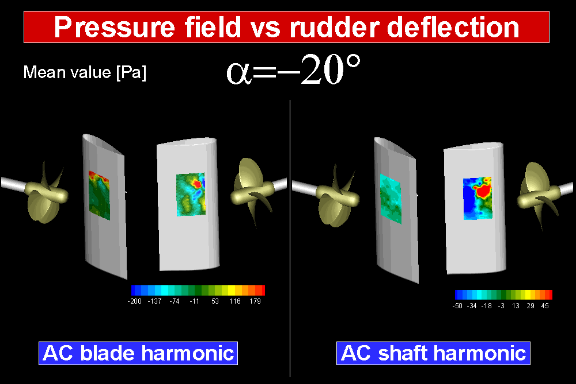


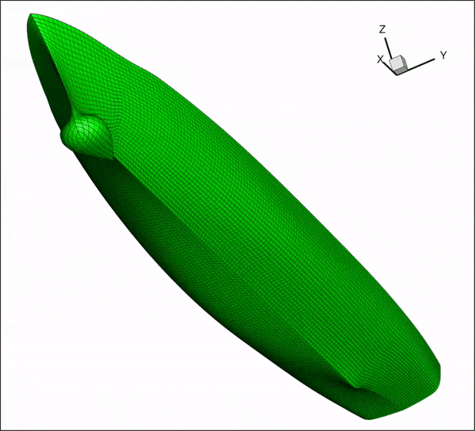
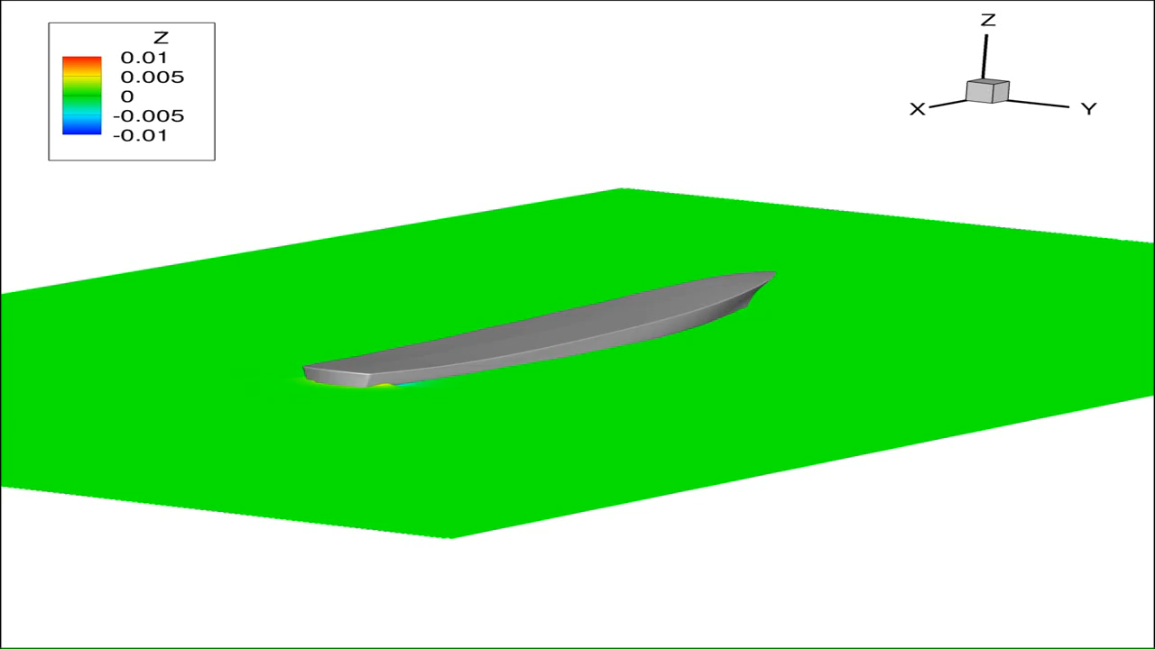

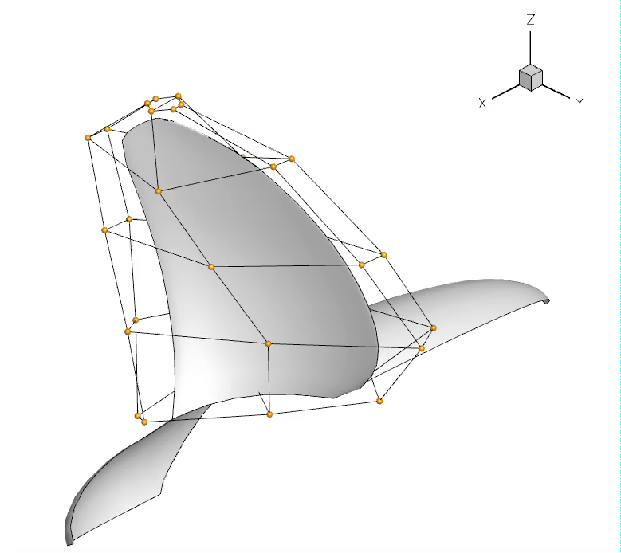
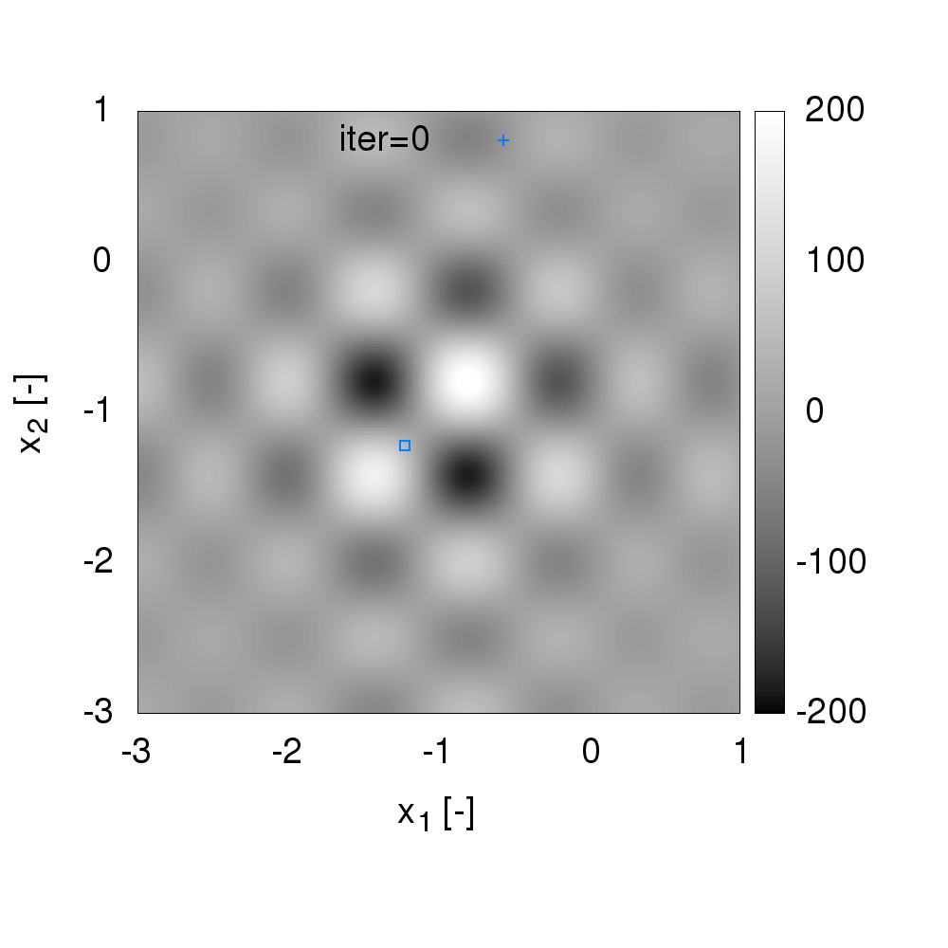
Energy Efficiency via New Design & Retrofitting
Wave drag reduction via hull shape optimization
Original
Optimal A
Optimal B
Advanced propeller design
- 4%
- 4%

Slide 4
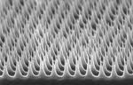

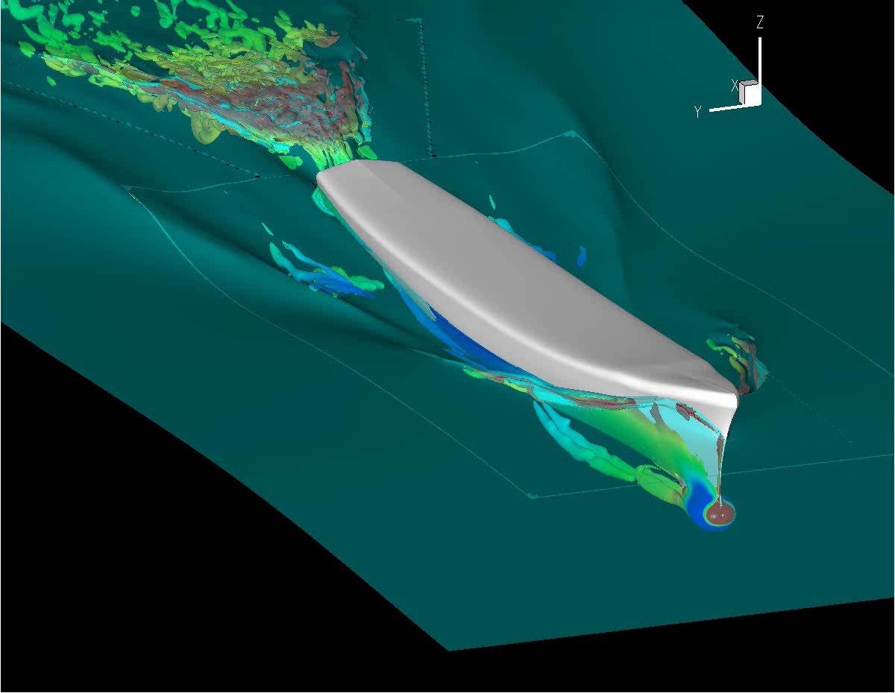
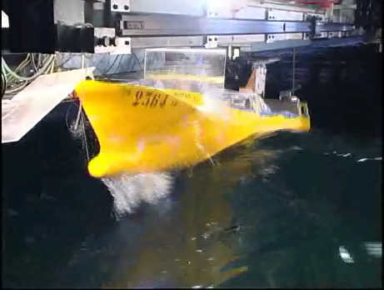
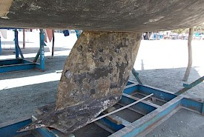
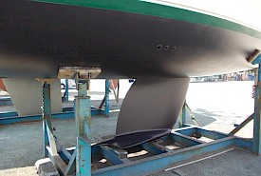
Energy Efficiency via New Materials
Lightweight materials
(aluminum, CF/GF Reinforced Polymers)
Structural Design
Load computation
Friction reduction via Super-hydrophobic coatings
Laboratory testing
Ultimate strength & fatigue
Friction reduction via fouling monitoring and antifouling solutions

Slide 5
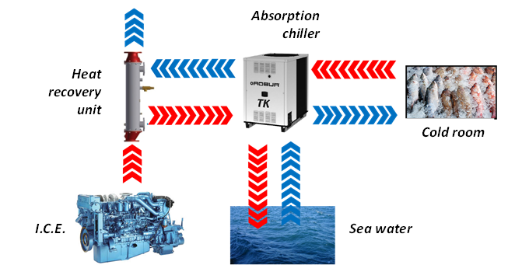
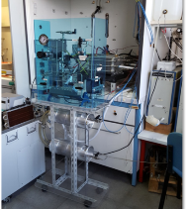
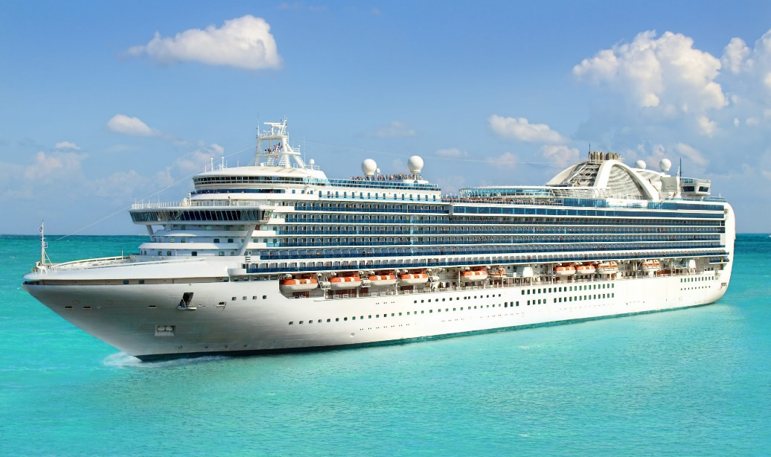
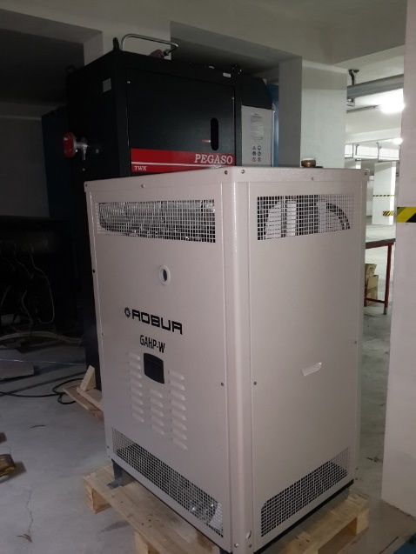
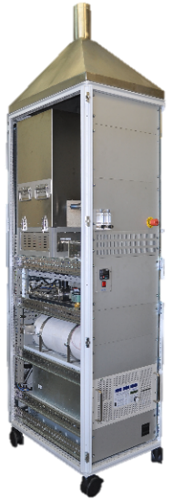
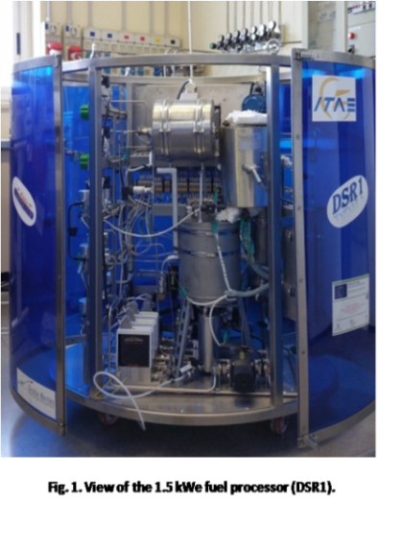
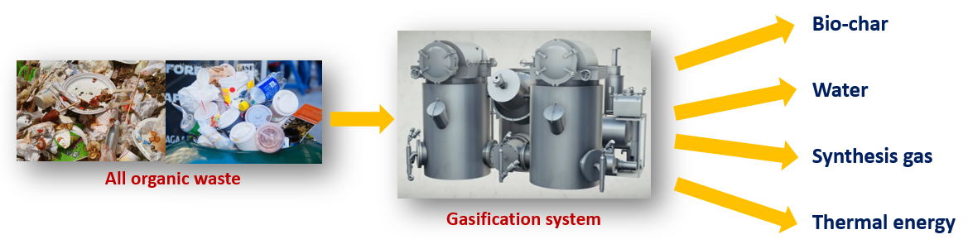
Energy Efficiency via Waste Recovery
Polymer Electrolyte Fuel Cells for APU
Waste heat recovery
Fuel cells
Solid oxide Fuel Cells
Waste-thermo chemical conversion
Fuel Processor System

Slide 6

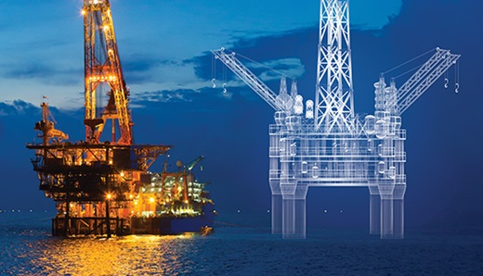
Energy Efficiency via Digital Technologies
What is a digital twin?
“A Digital Twin is an integrated multiphysics, multiscale, probabilistic simulation of an as-built […] system that uses the best available physical models, sensor updates […] to mirror the life of its corresponding […] twin” (Glaessgen and Stargel 2012)
“A digital copy of the physical system to perform real-time optimization” (Söderberg et al. 2017)
What are its main characteristics?
Connectivity
  Sensors
  Internet of Things (IoT)
Data fusion and assimilation
  Multi-information sources
  Physics-based and data-driven models
Adaptivity
  Learn from data
  Evolve with the real-world twin
Modularity
  Multiple subsystems
medium.com
rina.org
Glaessgen, Edward, and David Stargel. "The digital twin paradigm for future NASA and US Air Force vehicles.“ In: 53rd AIAA/ASME/ASCE/AHS/ASC Structures, Structural Dynamics and Materials Conference 20th AIAA/ASME/AHS Adaptive Structures Conference 14th AIAA. 2012.
Söderberg, Rikard, et al. "Toward a Digital Twin for real-time geometry assurance in individualized production.” In CIRP Annals 66.1 (2017): 137-140.

Slide 7
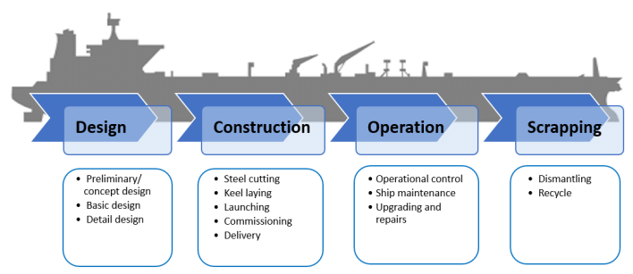
Energy Efficiency via Digital Technologies
Digital models
Real world
Physics-based models
Data-driven models and machine learning (ML) methods
Sensors
Digital twinning methods, data fusion and assimilation approaches
Optimization and AI
  Design and construction
  Management and control
  Dismantling
ICT platform
Physics-based models
Sensors
Data-driven models
ML and
data fusion/ assimilation
Digital Twin
Optimization and AI

Slide 8
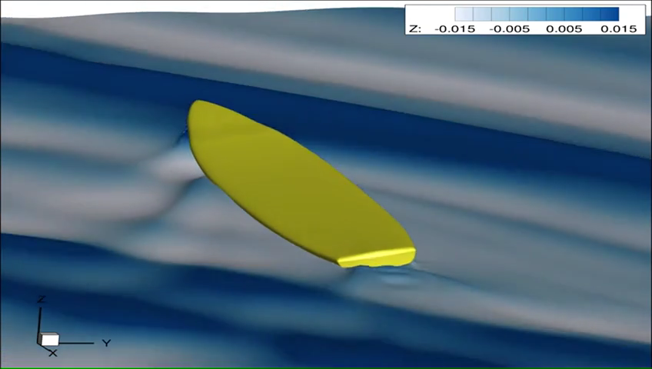
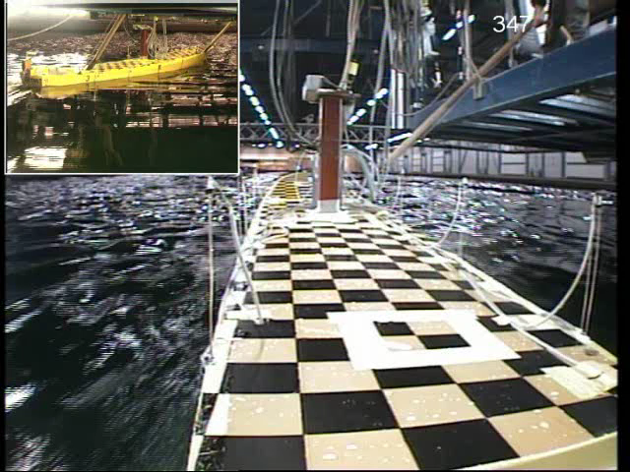
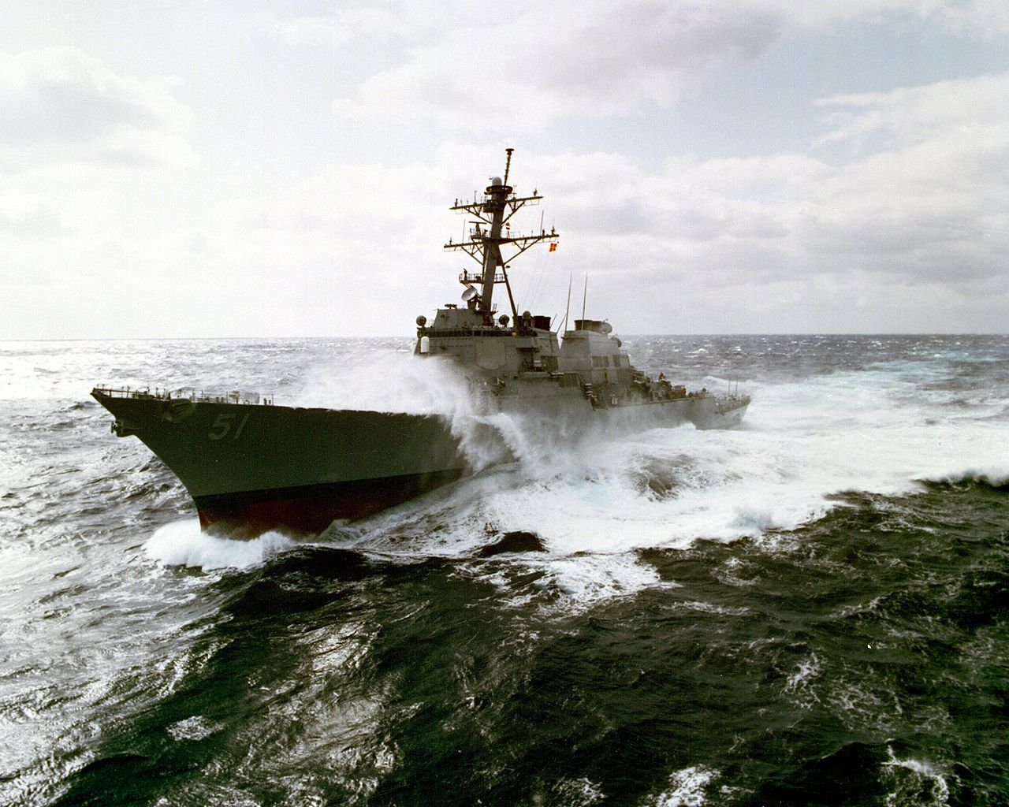


Energy Efficiency via Digital Technologies
URANS simulations of a naval destroyer in heavy weather (sea state 7)
Validated against experimental data
Credits: CNR-INM and University of Iowa (simulations), MARIN (experiments),
Sponsors: US Department of the Navy Office of Naval Research; Seoul National University, Korea
Acknowledgements: NATO AVT-280 “Evaluation of Prediction Methods for Ship Performance in Heavy Weather”

Slide 9
Energy Efficiency via Digital Technologies
How the digital twin can contribute to improve efficiency and GHG emissions:
Improved and more efficient Ship Design
Decision Support System
  Ship Routing
  Ship navigation and Port logistics
  Systems and Structural health monitoring, Predictive maintenance
  Fault detection
  Smart energy management on board

Slide 10
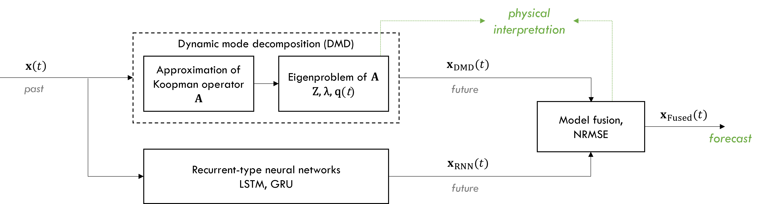
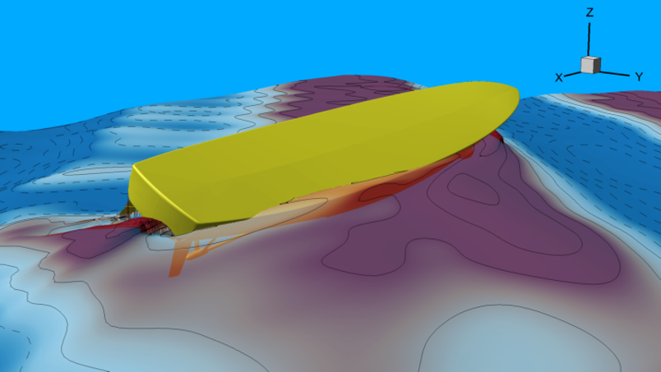
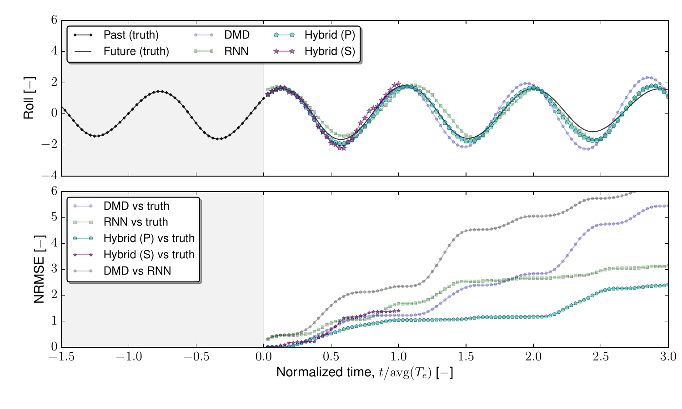
Energy Efficiency via Digital Technologies
Improving Knowledge, Prediction, and Forecasting of Ships in Waves via Hybrid Machine Learning Methods (NICOP-FORWARD)
Data-driven modeling of ships maneuvering in waves
Hybridization or NN (RNN, LSTM, GRU) approaches with modal decomposition methods (DMD)
Good prediction of nonlinear dynamics
Good interpretability

Slide 11
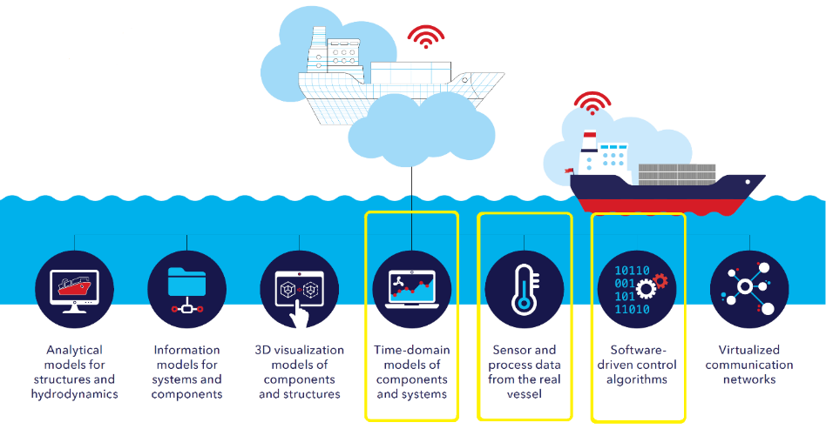
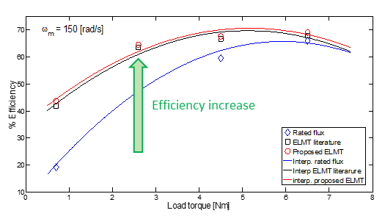
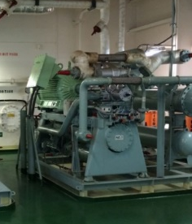
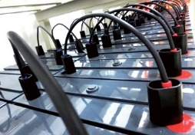
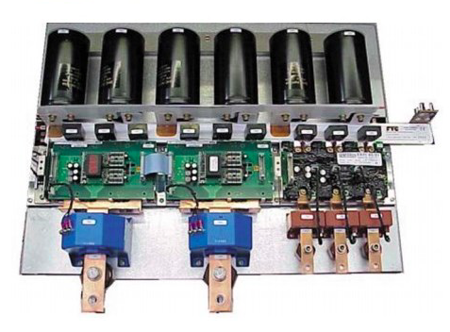
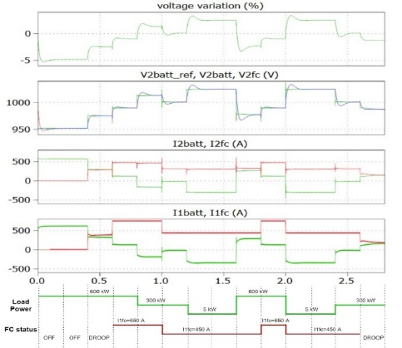
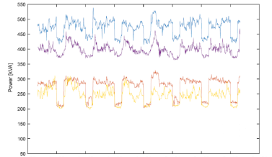
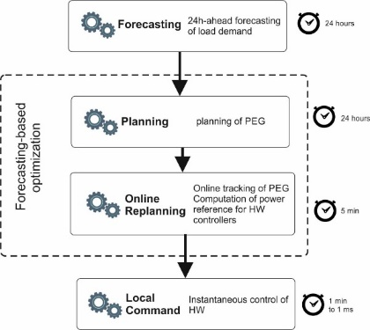
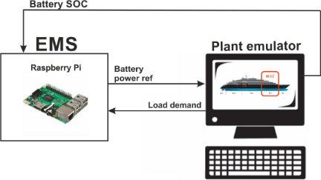
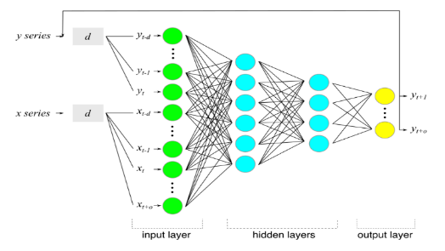
Energy Efficiency via Smart Energy Management
Time domain simulations of :
Power converters for distributed generation, electrical storage and load interface to the shipboard electrical system
Simplified shipboard microgrid models for assessment of novel efficient distribution schemes (e.g., DC-based)
Software-based control of shipbord electrical drives (e.g., propulsion, HVAC,…) for increased efficiency:
Electrical Loss Minimization Techniques (ELMTs)
Artificial intelligence (AI)-based forecasting of electrical load demand using data series from the real vessel
Optimization-based Energy Management System (EMSs) for the efficient use of electrical power onboard

Slide 12
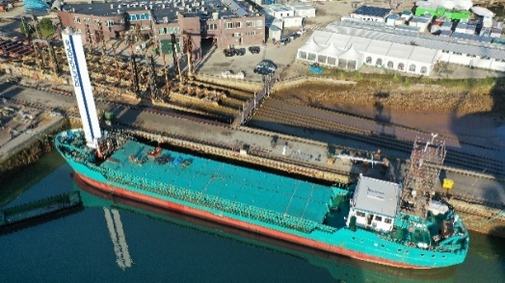
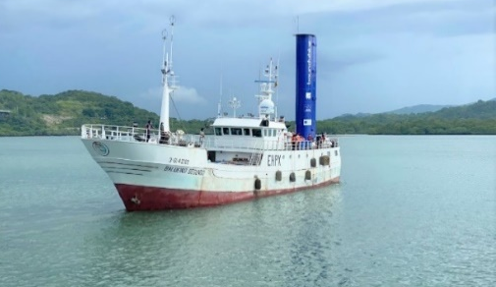
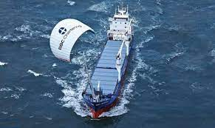
Renewables in Shipping - Sails
Wind-Assisted Ship Propulsion (WASP)
Kites
Rigid and flexible sails
Applications to large ships:
Wind direction constant for long distances
Upper deck not always free (e.g. containerships)
Abatement solutions for the mast of the rigid or flexible sails for maneuver at port and berthing
Extended digital model and new ship routing accounting for wind direction
Credits: www.bound4blue.com
Credits: www.goodnewsnetwork.org/skysail

Slide 13
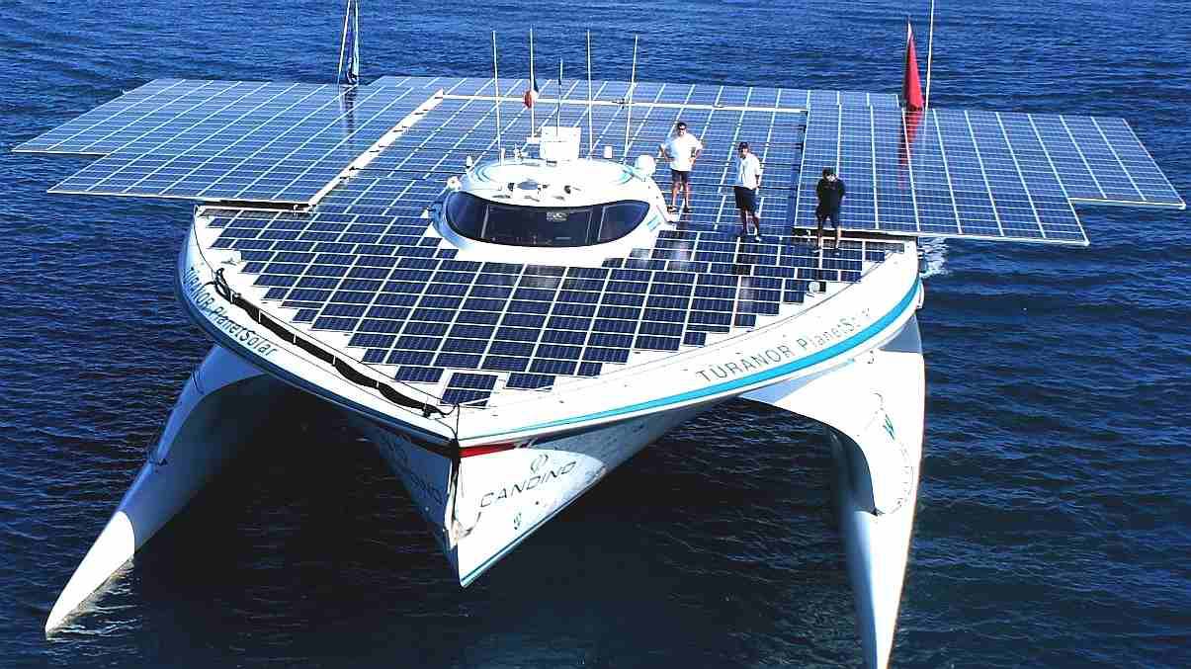
Renewables in Shipping - Solar
Solar (PV) panels
Applicable on deck of some specific ships
Not suitable for containerships
Energy for on board auxiliaries
Innovative paintings for integrated photovoltaic (perovskite-based) for future applications
Turanor PlanetSolar
Credits: www.elizabethqueenseaswann.com

Slide 14
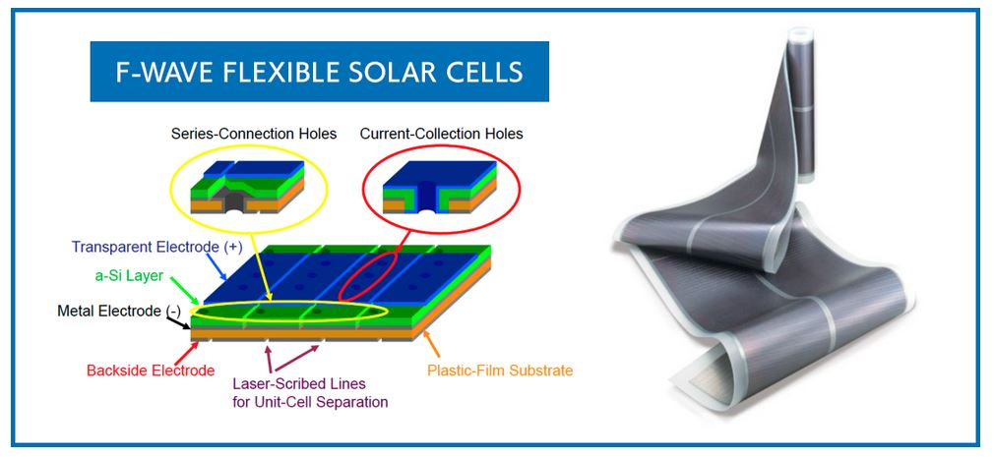
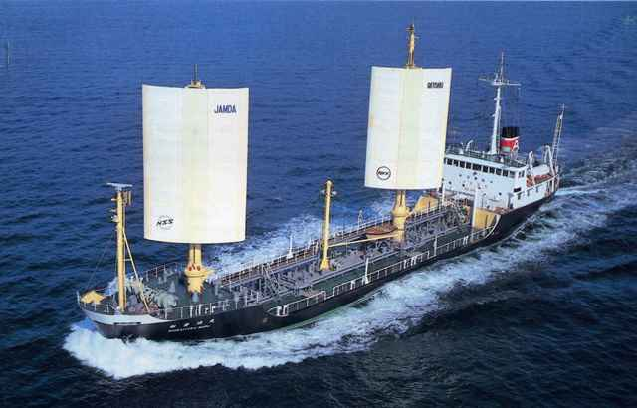
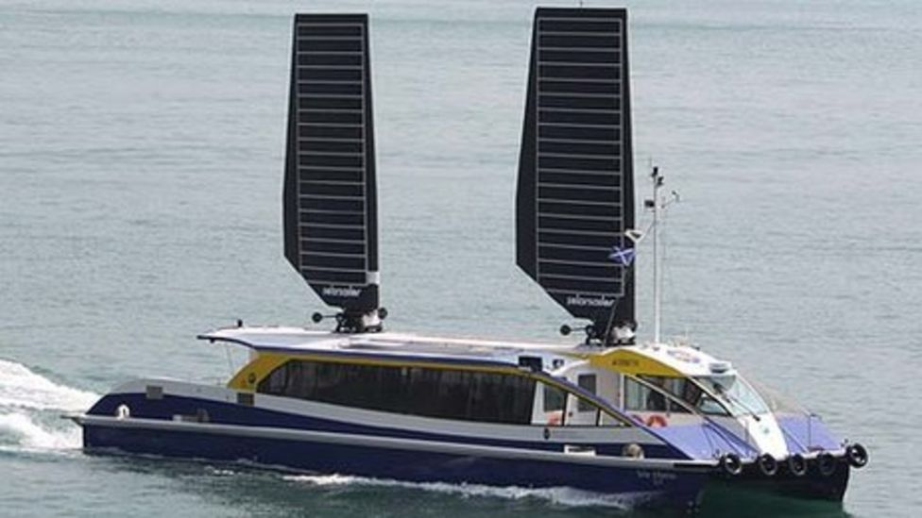
Renewables in Shipping – Solar & Sails
Sails covered by flexible solar (PV) panels to combine the two renewable energy solutions
Credits: www.offshore-energy.biz
Credits: www.ecomarinepower.com
Credits: www.bbc.com

Slide 15
Efficiency and renewable energy exploitation in shipping
One-size fits all approach not applicable to the shipping sector: each ship has specific needs and constraints
A combination of different solutions has to be exploited in order to achieve the maximum reduction of harmful emissions
The ocean is a rather harsh environment and the ship and her onboard systems have to be designed to guarantee the safety in all conditions

