Slide 1



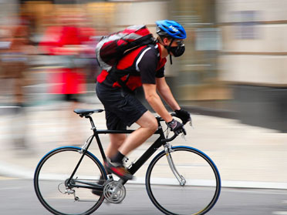
Luc Int Panis
Is urban cycling healthy or not?
NO2NOGRAZIE
24 February 2020
Cittadina per l’aria
Milano

Slide 2
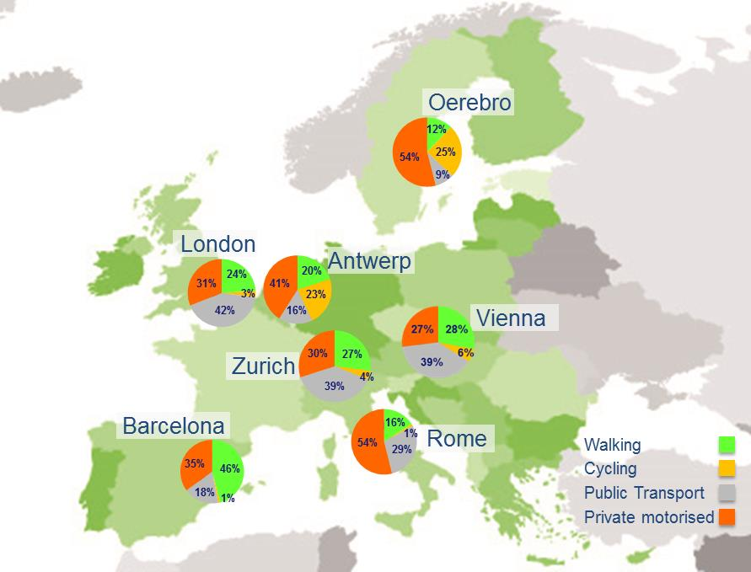
Seven European Case Study Cities (CSC)
Modal Split
Vienna
Zurich
Antwerp
Barcelona
Oerebro
Rome
London
(Borough of Newham)
@EUPASTA
@PASTA_Antwerpen

Slide 3






Sedentary behavior kills
People are not (physcialy) active enough
5M
30% INACTIVE ADULTS
30%
Inactive Adults
PREMATURE DEATHS

Slide 4
Active mobility is a potential solution for health & climate & …
80%
50%
TRIPS <5 km
BY CAR
URBAN EUROPEANS
IN 2030
Notes:
Interessante aanpak waarbij potentieel van stadsontwerp benut wordt. Zeker als we weten dat meer dan 80% van de Europese bevolking in 2030 in een stedelijke omgeving zal wonen
Voorlopig wordt nog 50% van verplaatsingen minder dan 5 km met auto gemaakt.
Hieruit ontstond het PASTA project
- Europees onderzoeksproject waarin in 7 steden werd onderzocht hoe actieve mobiliteit gepromoot moet of kan worden om de gezondheids van burgers te verbeteren?

Slide 5


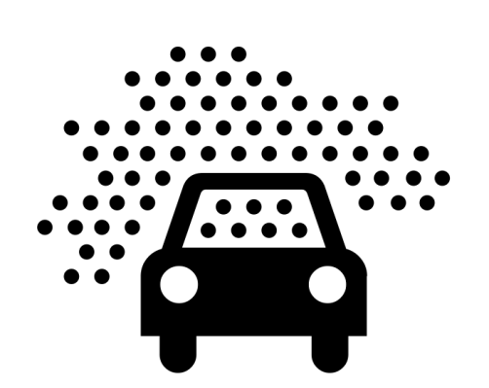

Burning less fuels in cities has important co-benefits for health
Do the benefits of active mobility outweigh the risks?
4M
14 MONTHS LOST
PREMATURE DEATHS
WHO
Norm
µg/m³ PM_{2.5}
Notes:
Canva infographic
Luchtvervuiling in de stad.
Jaarlijks 4 miljoen doden + cardiovasc en respi aandoeningen (ERS)
Figuur WHO
Jaarlijks gemiddelde? Ik denk het wel.
BCN 14 maanden levensverwachting verloren, Brussel 7 en Londen 3

Slide 6
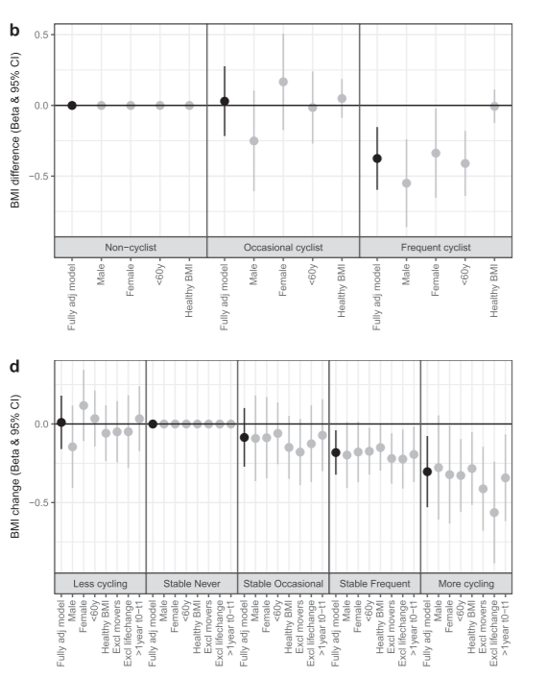
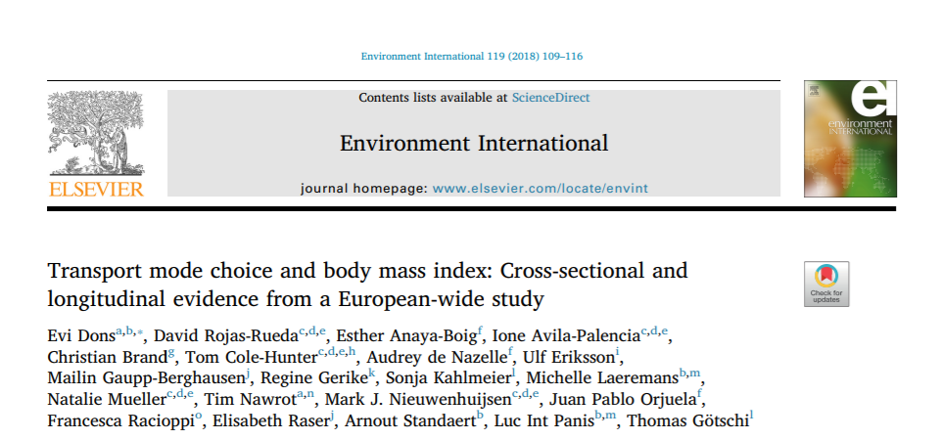
Cycling makes you thinner (1-4 kg)

Slide 7
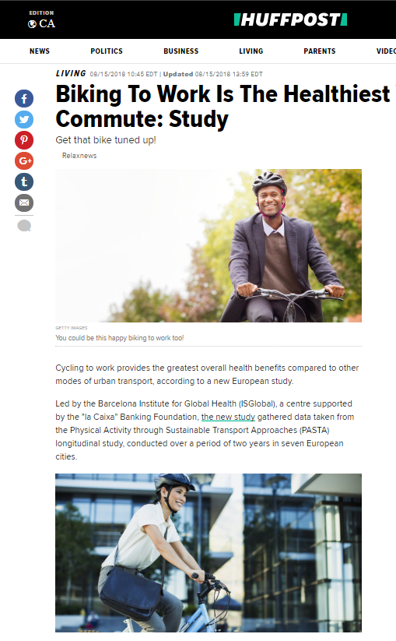
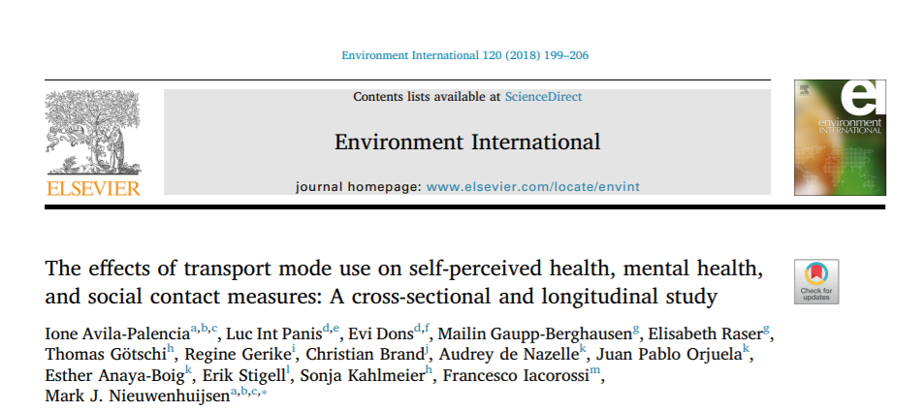
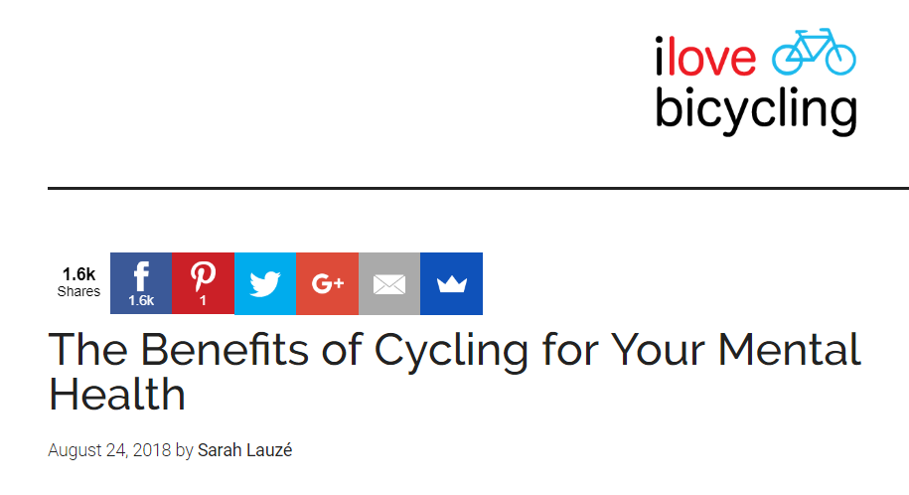

Cycling is good for mental health

Slide 8
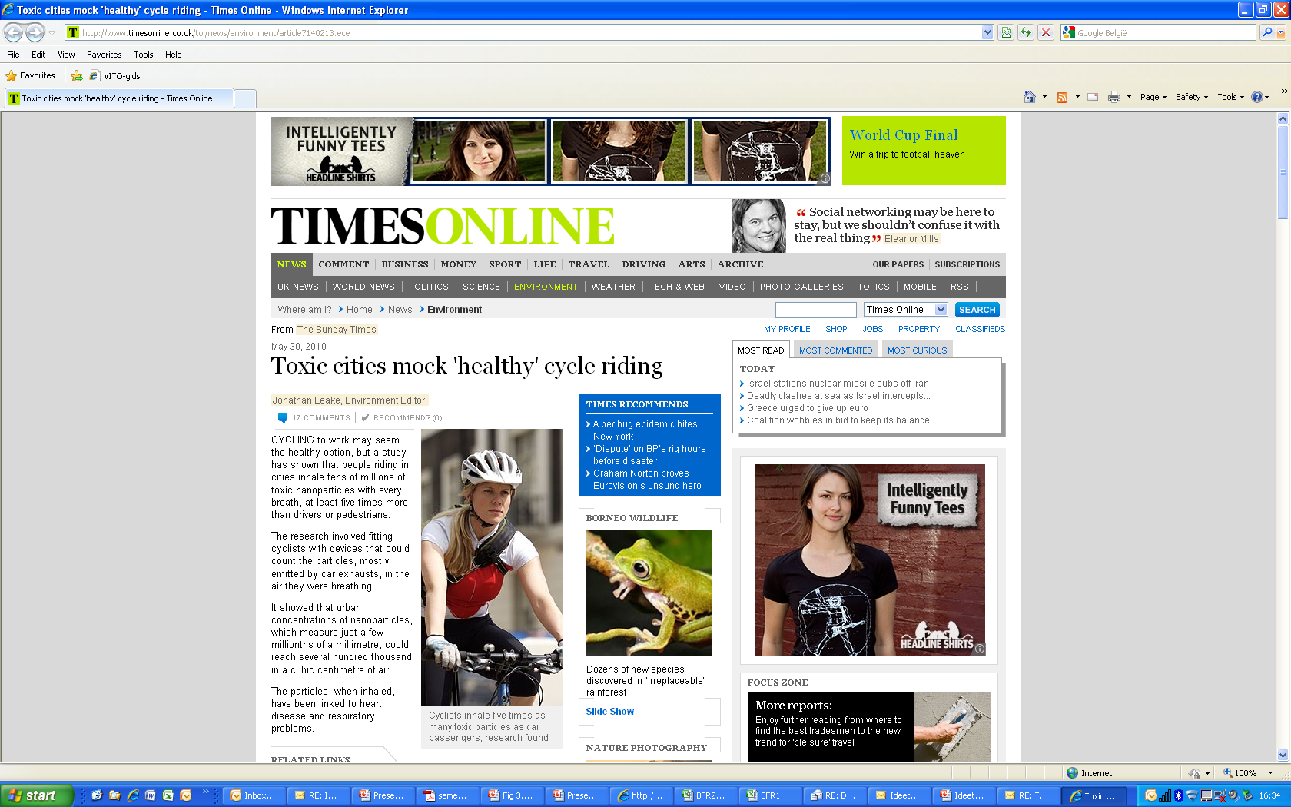

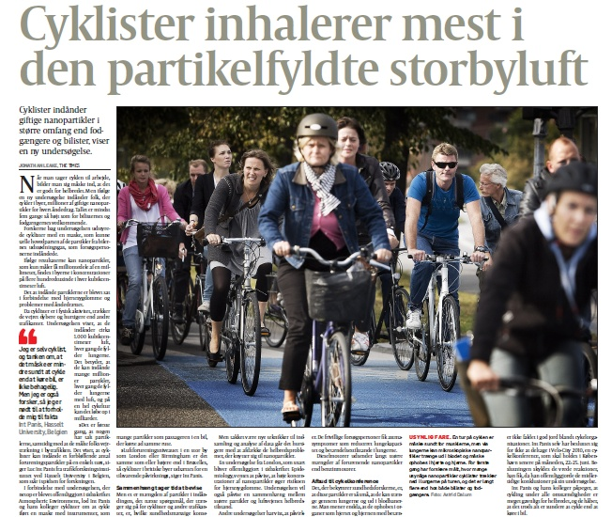
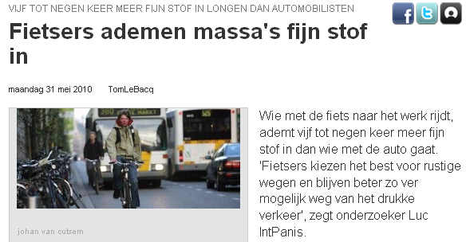
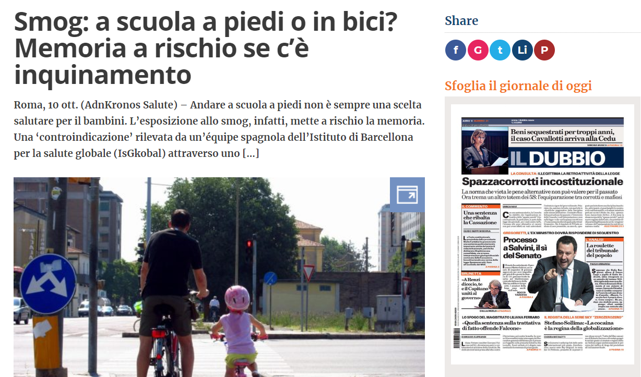
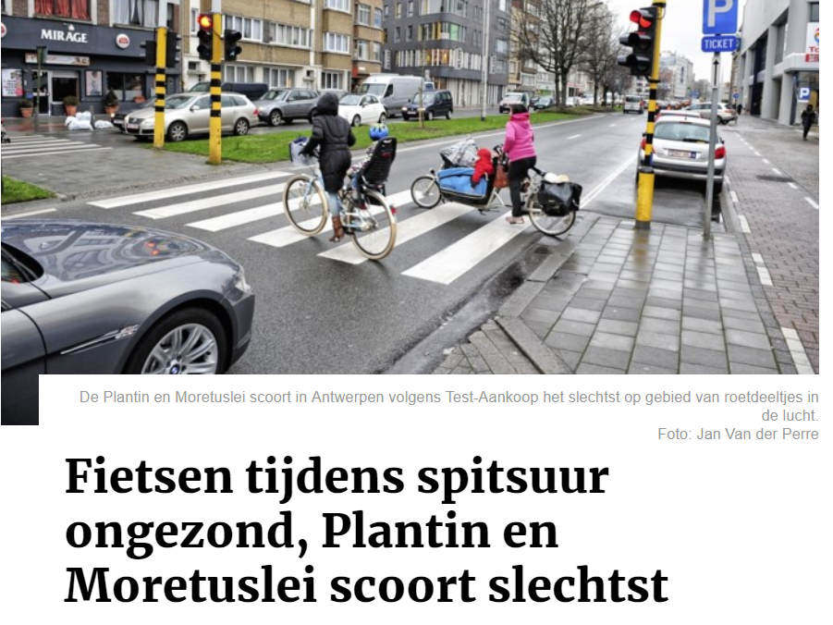
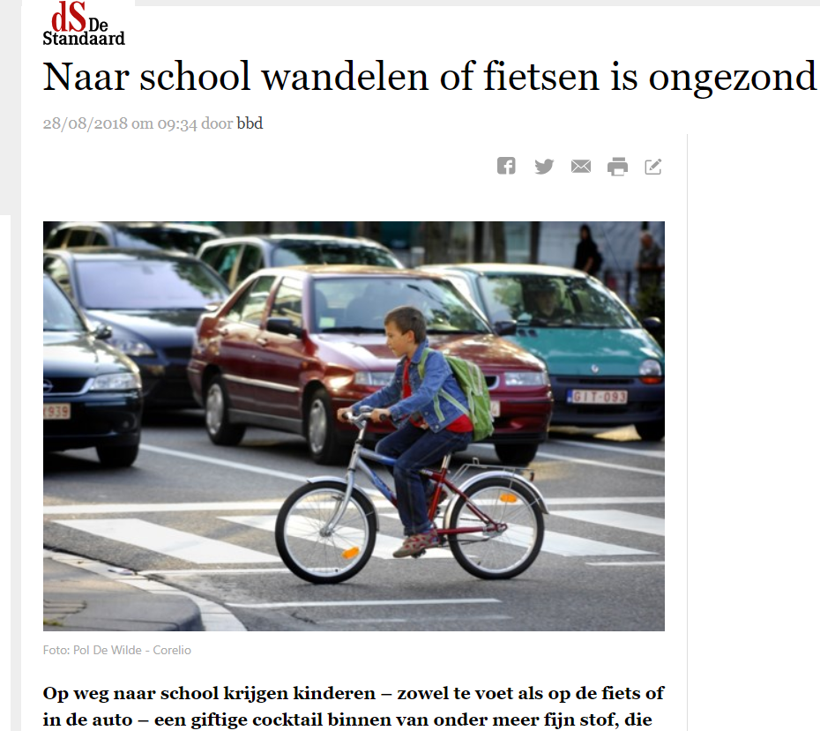
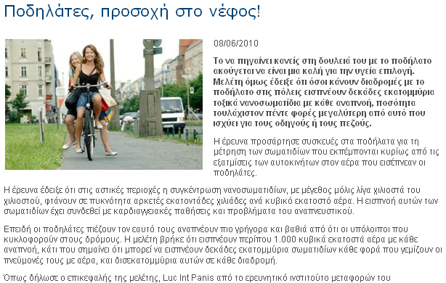
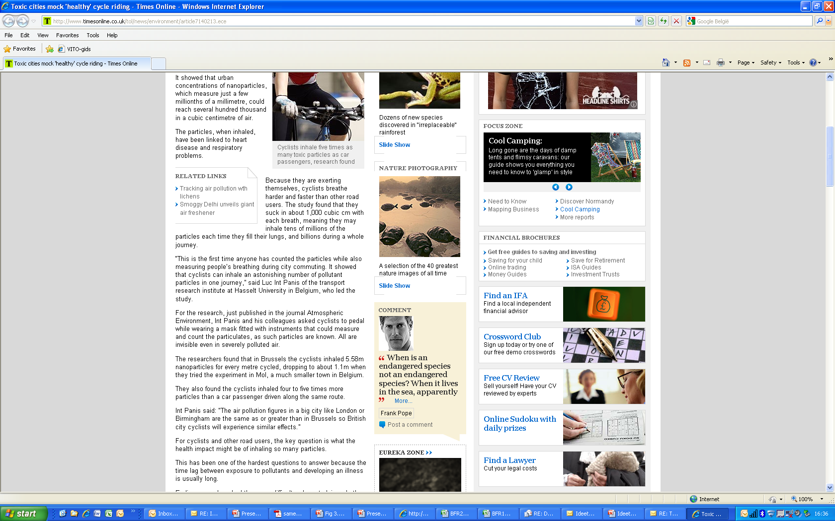


Slide 9

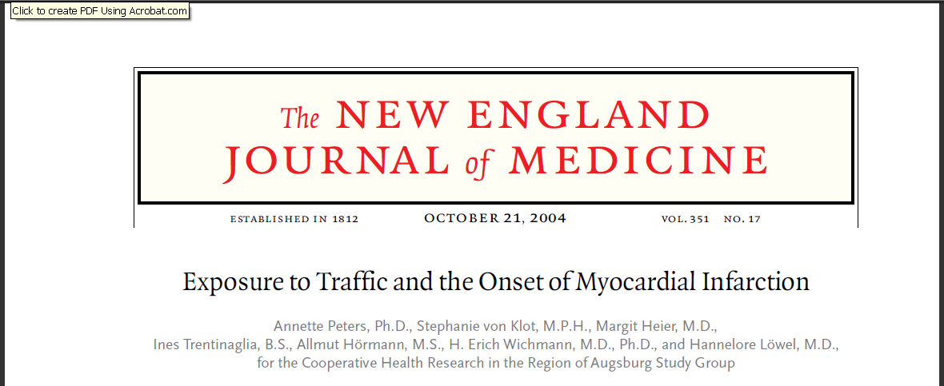
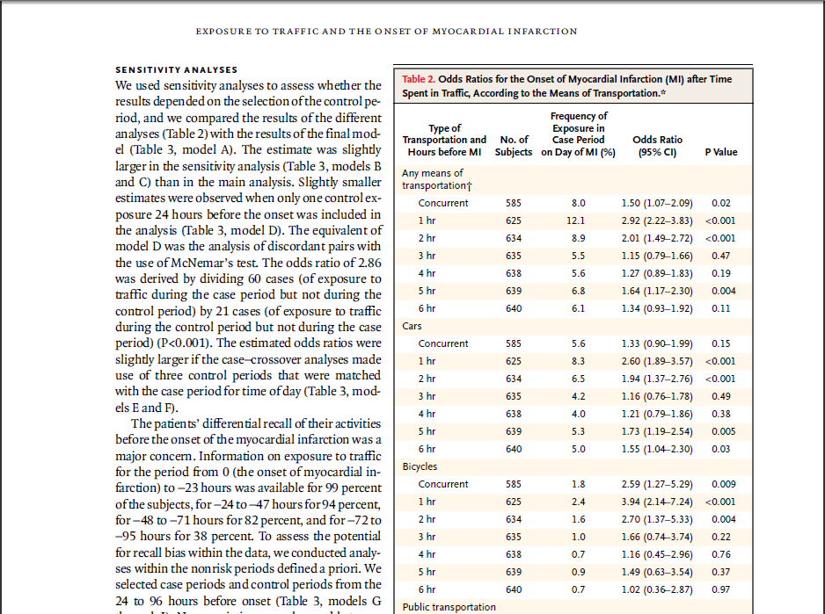
Risk for Myocardial infarction

Slide 10
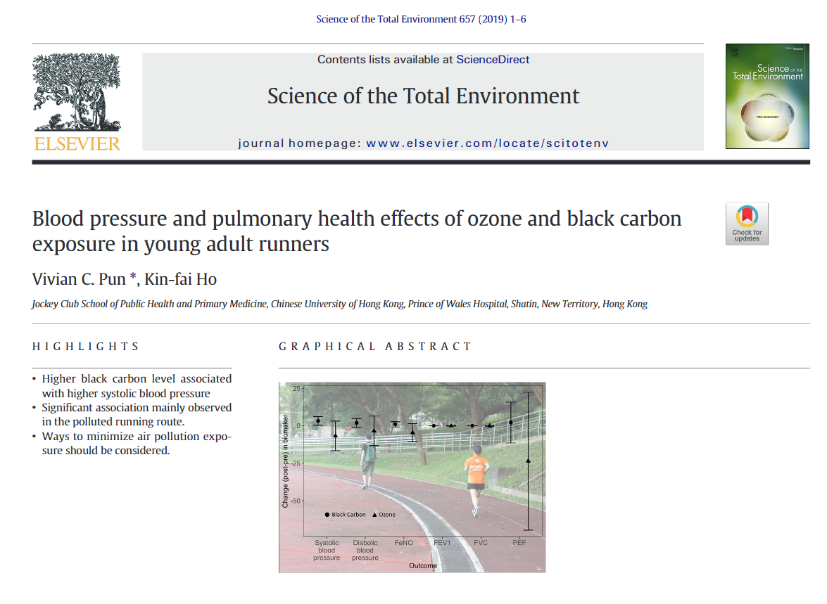
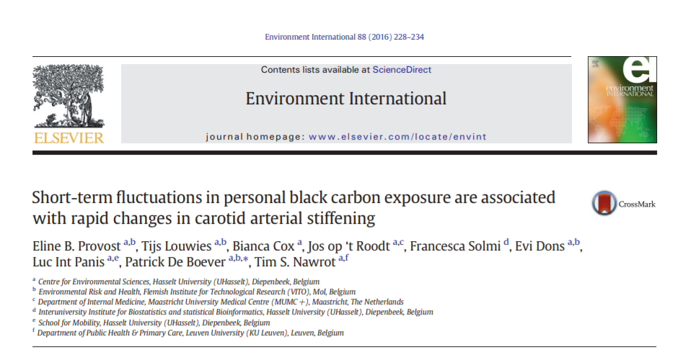
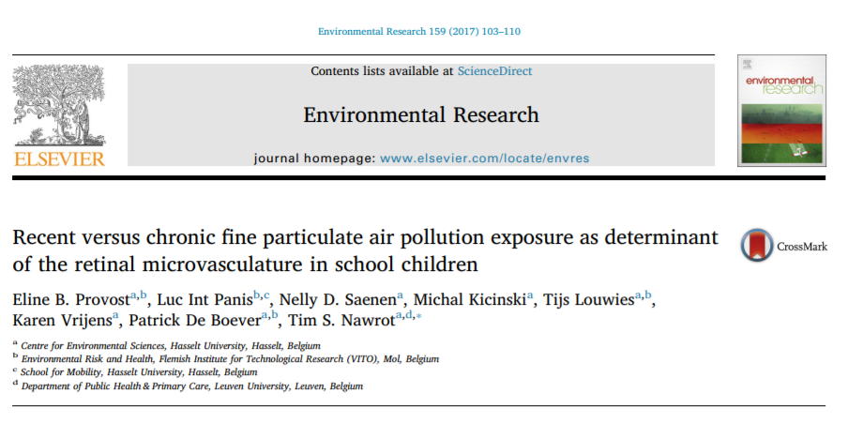
Air pollution causes cardiovascular effects

Slide 11
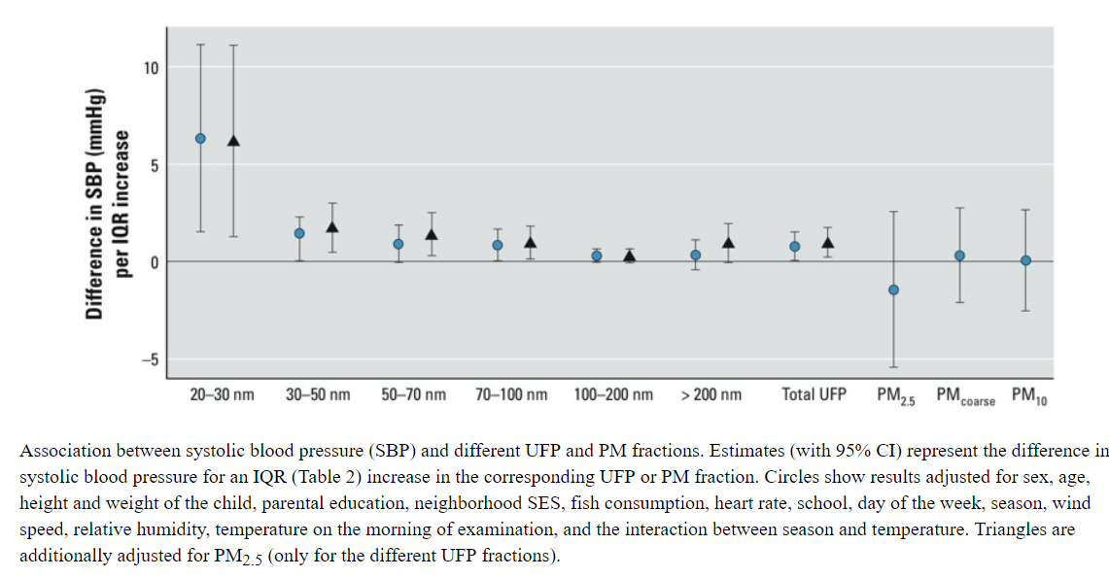
Air pollution increases blood pressure
Black Carbon from transport
https://www.researchgate.net/publication/273384658_Blood_Pressure_and_Same-Day_Exposure_to_Air_Pollution_at_School_Associations_with_Nano-Sized_to_Coarse_PM_in_Children

Slide 12

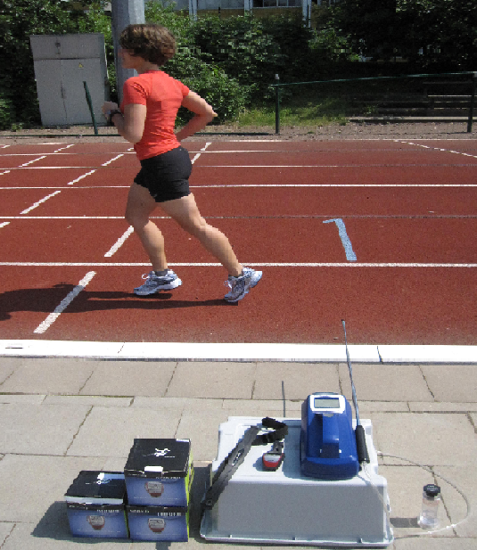
Start to Run experiment
  Effects of aërobic training
  urban <> rural
  Healthy inactive voluntueers
  12 weeks Start-2-Run
  3 sessions/week
  UFP- contrast (VUB Brussels – VITO Mol)
  Biological effects before & after
  (cognition, inflammation & BDNF)

Slide 13
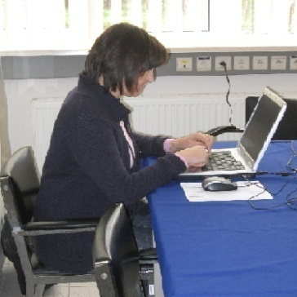
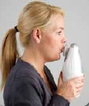
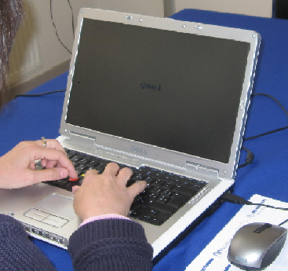
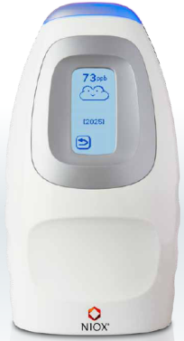
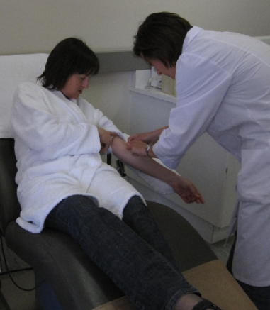
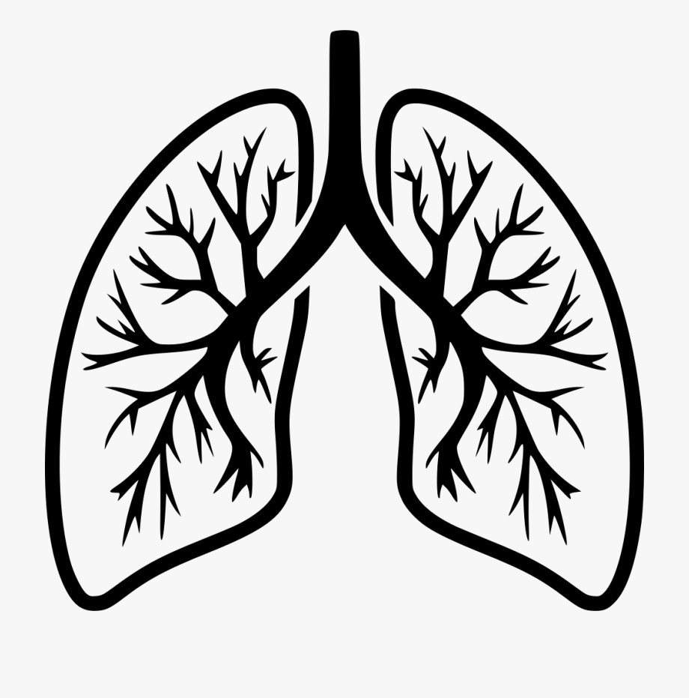
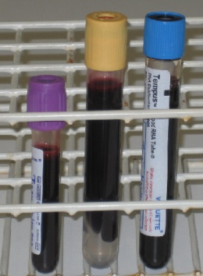
Biological effects only in the city
Cognitive tests
BDNF
Leucocytes
eNO

Slide 14
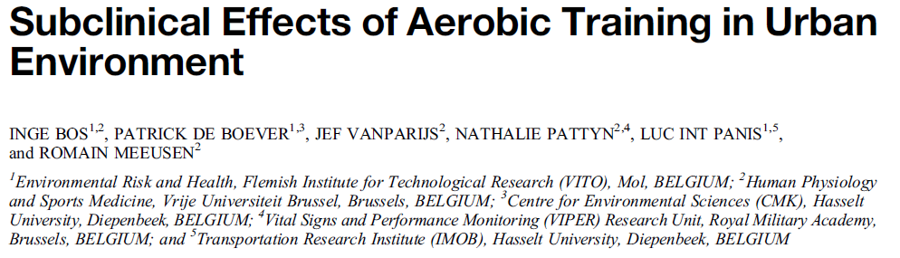
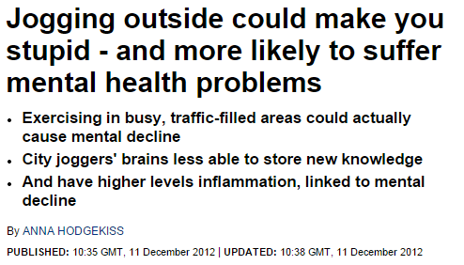
Conclusion S2R

Slide 15
Walking in Oxford street vs Hyde park
Astmatics walking in London
McCreanor et al. New Engl J Med. 2007

Slide 16
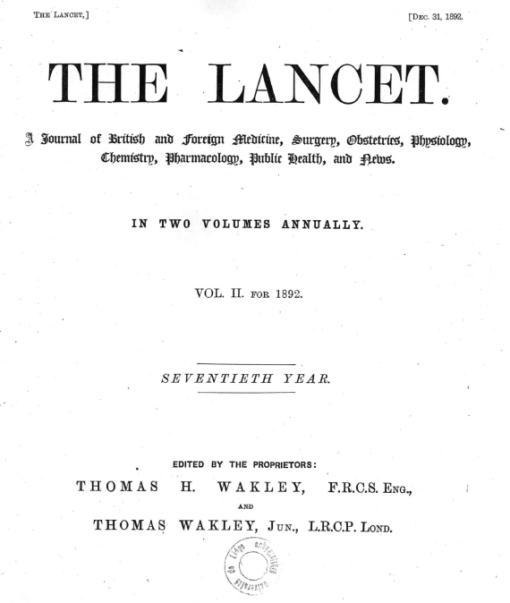
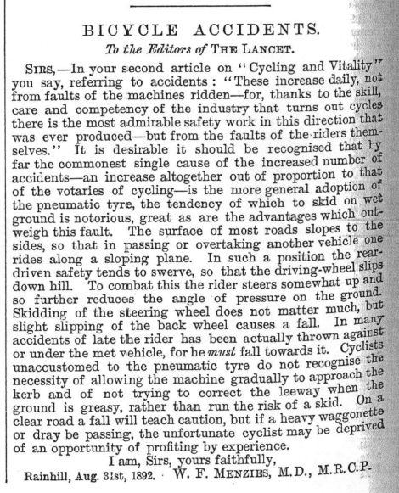
1892
Bicycle accidents: A big risk (in most cities)

Slide 17
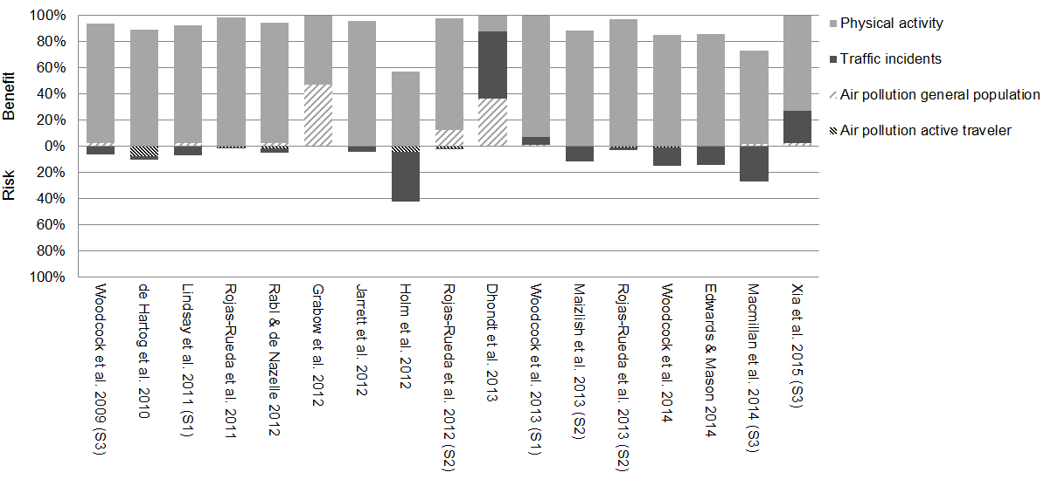
Overall health impact of a mode shift to active modes always positive
MUELLER et al. 2015. Health impact assessment of active transportation: A systematic review. Prev Med, 76, 103-14.

Slide 18
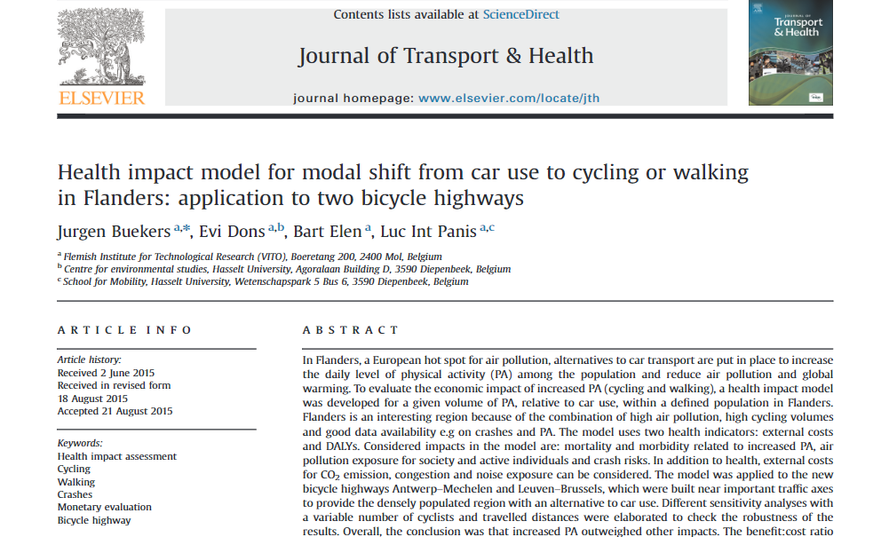
Cost-benefit ratio 2-14 !
https://www.researchgate.net/publication/281612872_Health_impact_model_for_modal_shift_from_car_use_to_cycling_or_walking_in_Flanders_Application_to_two_bicycle_highways

Slide 19
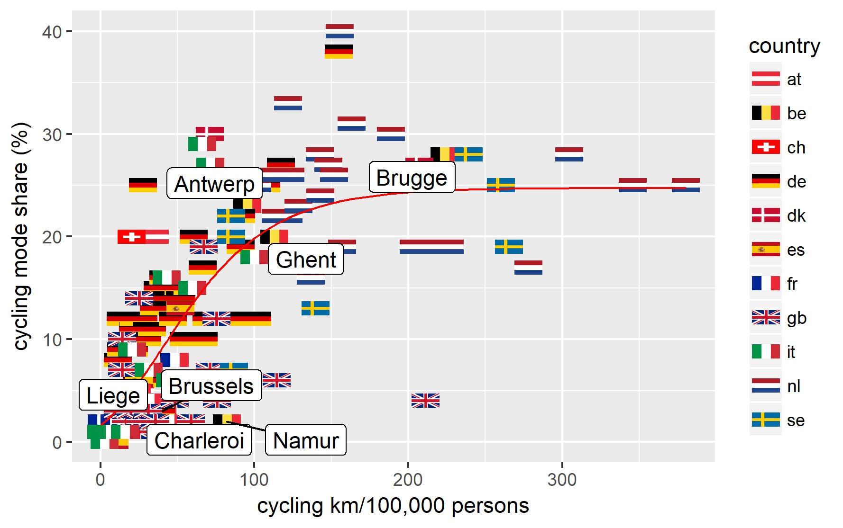
Mueller et al 2018 (Preventive medicine): Figure Maelle Salmon
% Cyclists
Roma

Slide 20
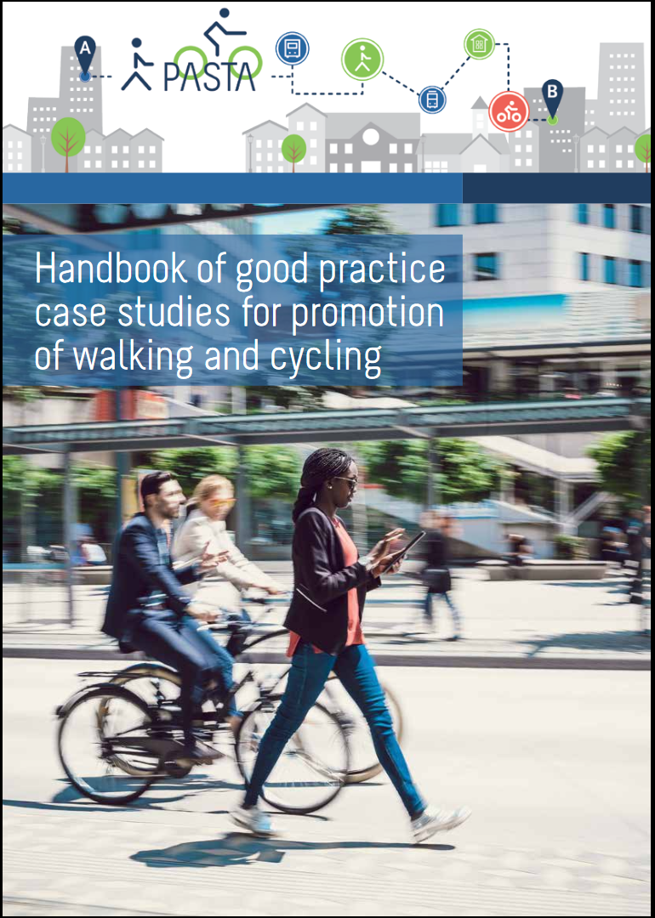




Information and contact:
grazie per l'attenzione
Twitter:
@EUPASTA
@PASTA_Antwerpen
@LucIntPanis
Francesco Iacorossi
@francis_rojo
E-mail: luc.intpanis@vito.be
luc.intpanis@uhasselt.be

