Slide 1

The CurieuzeNeuzen citizen science project in Belgium
Evi Dons, PhD (evi.dons@uhasselt.be)

Slide 2

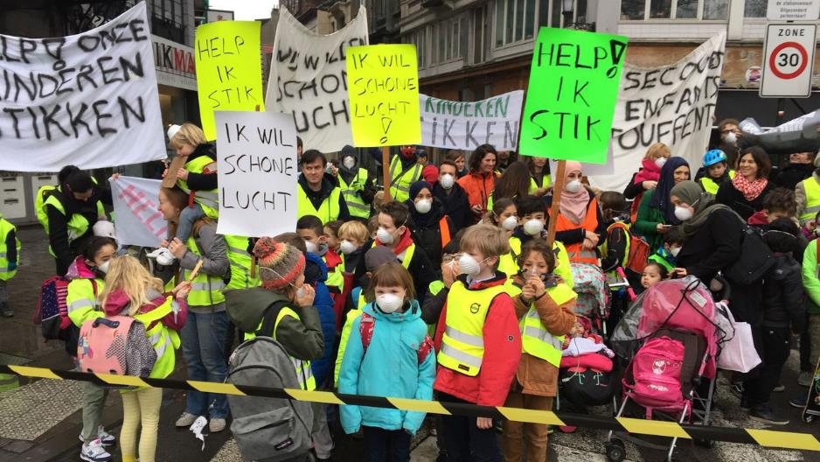
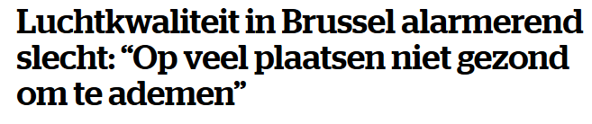

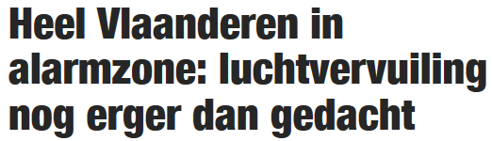
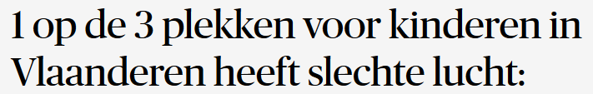

Slide 3
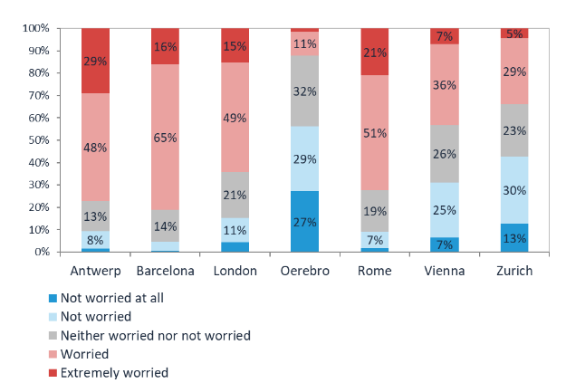
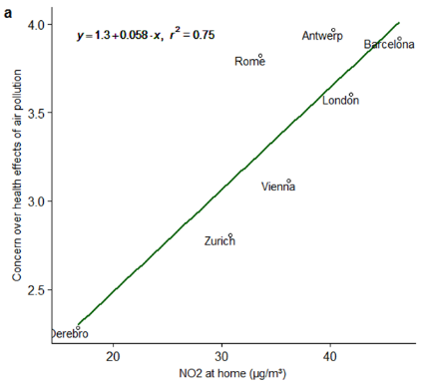
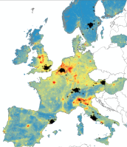

Concern over health effects of air pollution
NO₂
Being male, having children in the household, being more physically active, and higher NO₂ at the home address
→ higher concern over health effects of air pollution
Dons et al., Air Qual. Atmos. Health, 2018
Notes:
77% in Antwerp is worried or extremely worried
People have reasons to be concerned

Slide 4

The CurieuzeNeuzen project

Slide 5
Aims of the project
Science
Citizen
Collect data
Publish
Inform
Raise awareness

Slide 6
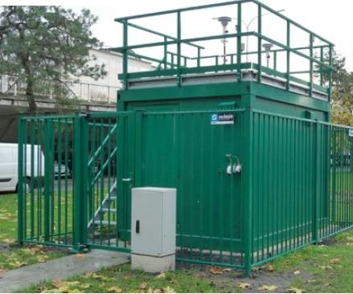
Aims of the project
Fixed monitoring station managed by the government

Slide 7



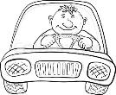
Aims of the project
Computer air pollution map
Computer model
Weather data
Traffic data
How reliable are these maps?

Slide 8
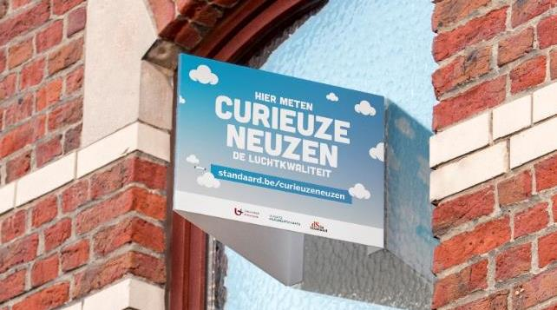
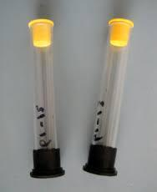
How?
Accessible and reliable method to measure NO₂
Palmes-type nitrogen dioxide diffusion tubes
Notes:
V-shaped panel to hold the tubes in a standardized way

Slide 9
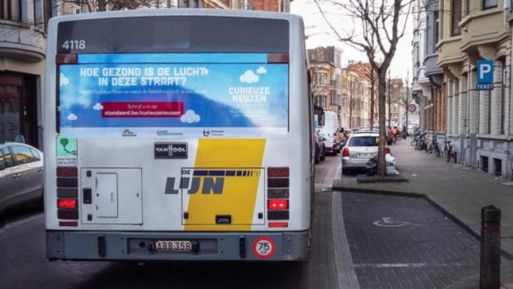
Recruitment of volunteers
Print media / newspaper
Film theaters
National Radio
National TV
Public spaces (buses…)
Social media
Famous participants

Slide 10

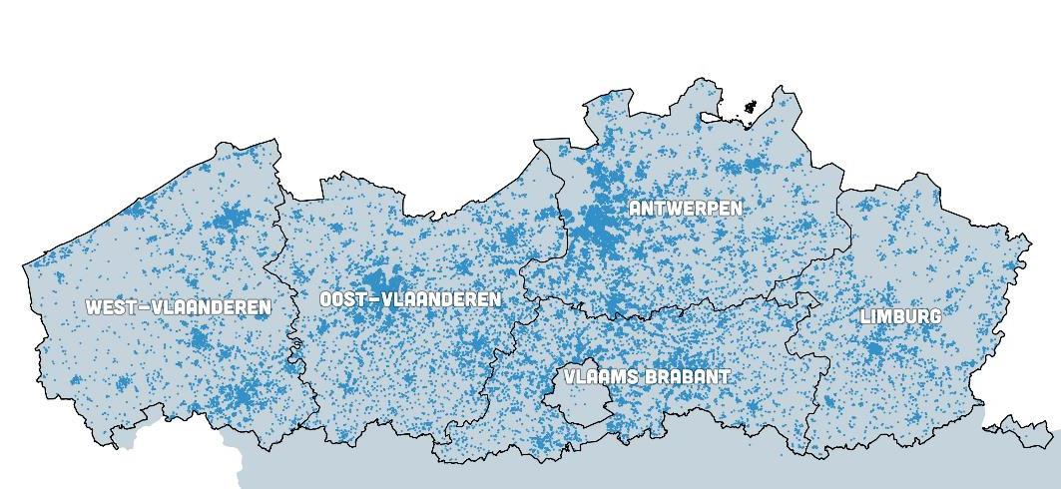
Recruitment of volunteers
52,630
22,000
4,000
3 h
3 days
3 weeks
Notes:
Selection of sample of 20,000
€10 to join the experiment

Slide 11
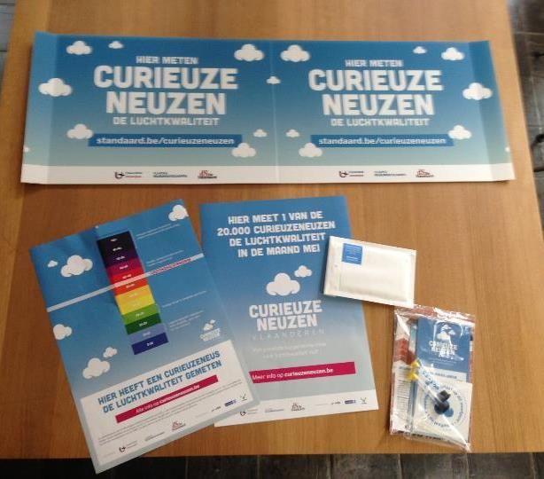
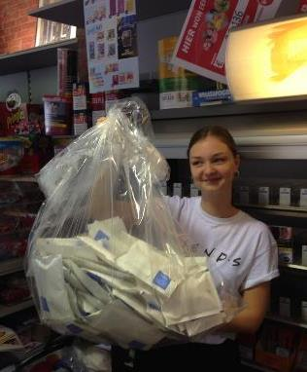
Monitoring campaign
April 2018: 20,000 families collect the measurement package
May 2018: 99% returns the NO₂ tubes

Slide 12
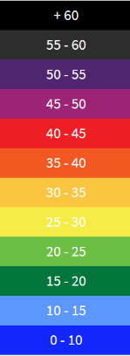
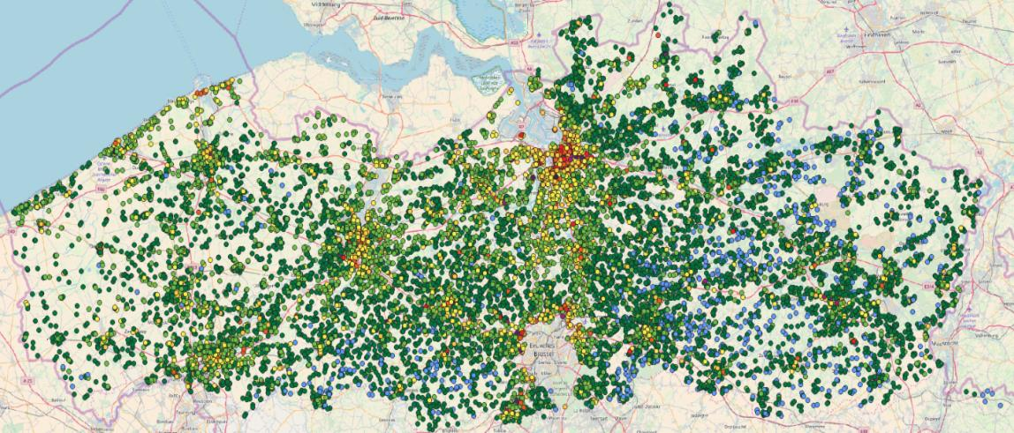
Results
NO₂
(µg m⁻³)

Slide 13
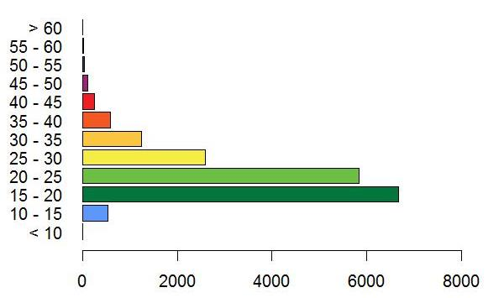
Results
Highest value = 75.3 µg m⁻³
2.3% above WHO guideline & EU standard
Average NO₂ = 22.8 µg m⁻³
Lowest value = 10.9 µg m⁻³
Number of measurements

Slide 14
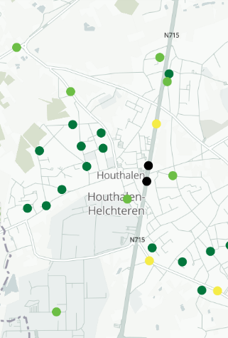
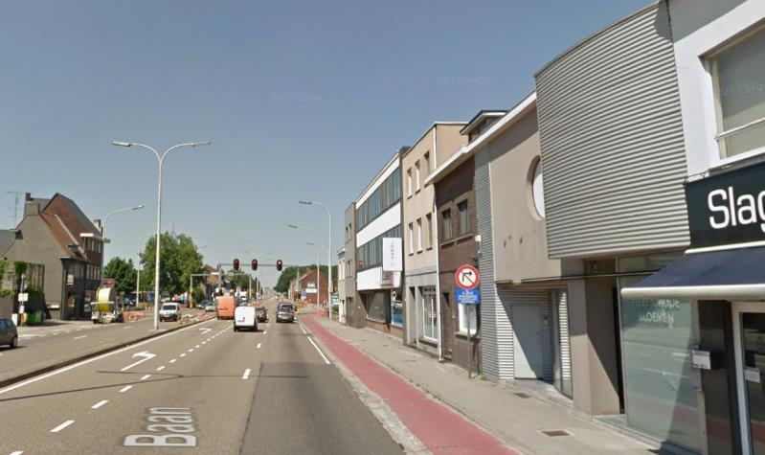
Highest value = 75.3 µg m⁻³

Slide 15
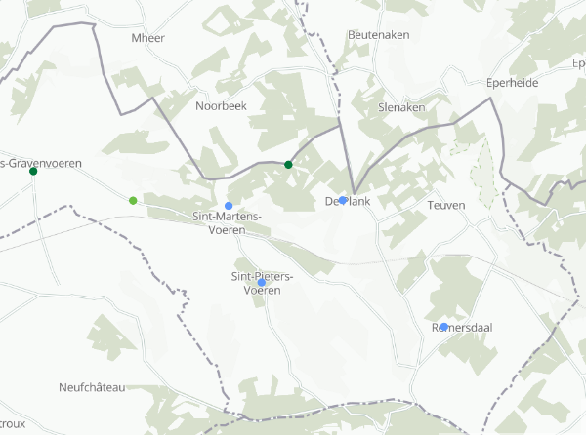
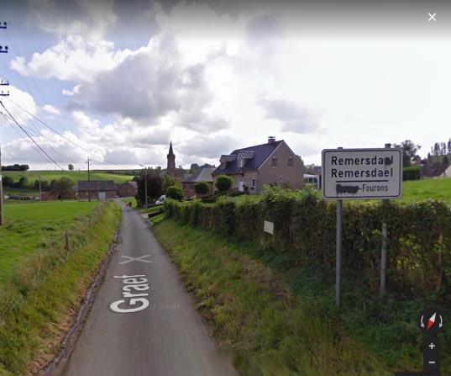
Lowest value = 10.9 µg m⁻³

Slide 16
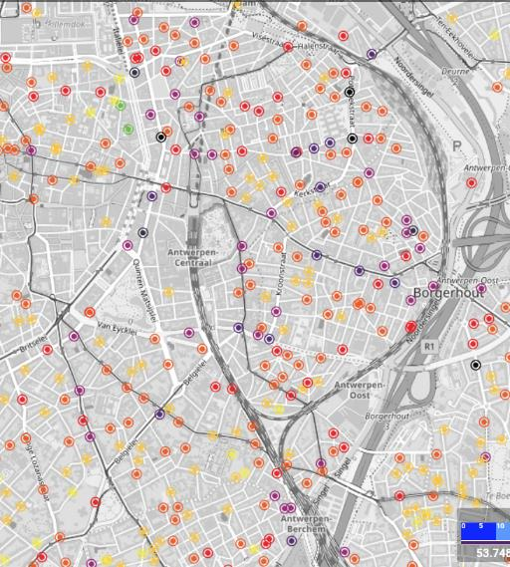
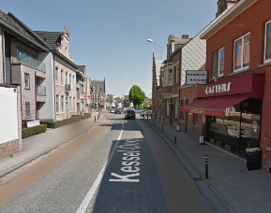
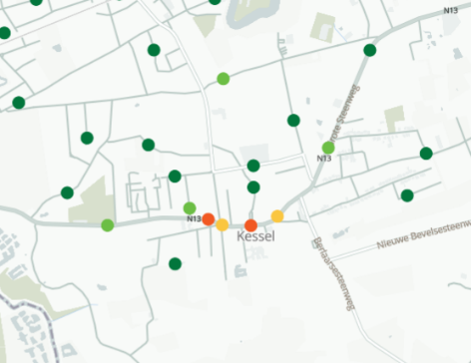
Street canyons
High concentrations in street canyons in cities
… but also in small villages

Slide 17
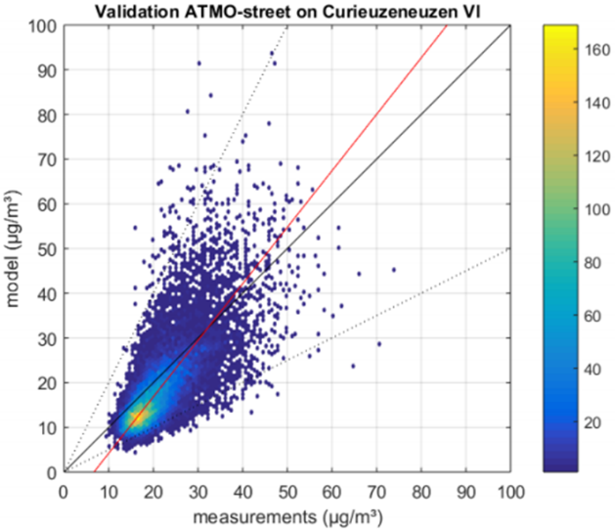
Validation of the air pollution model
Underestimation of the model
R² = 0.52
RMSE = 6.74 µg/m³
Model was improved after this external validation with new R² = 0.58
Notes:
Validation of AP model with external dataset (=CN)

Slide 18
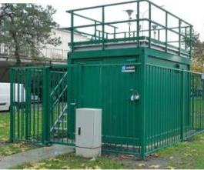
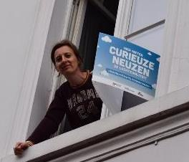
My inhaled dose?
Dons et al., Atmos. Environ., 2012
Notes:
1/3 dose at home
1/3 dose at work
1/3 dose while traveling

Slide 19



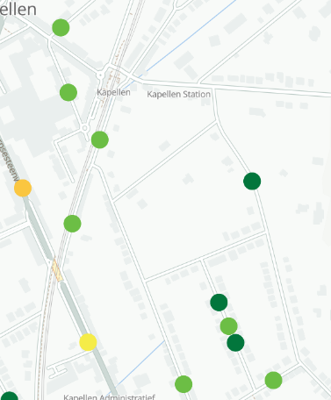
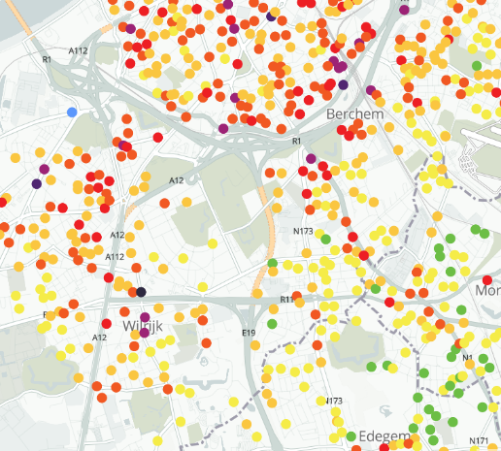
Home → train station
Train station → Work

Slide 20
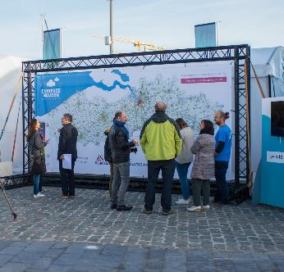
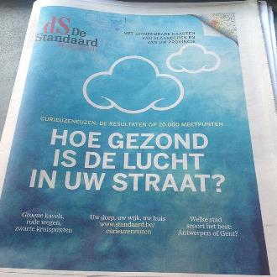
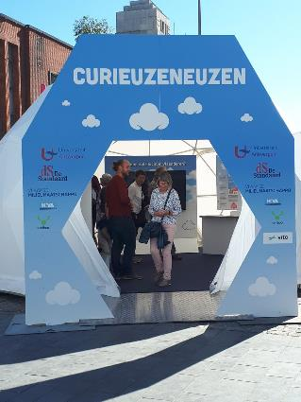
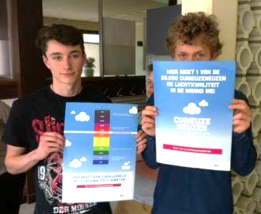
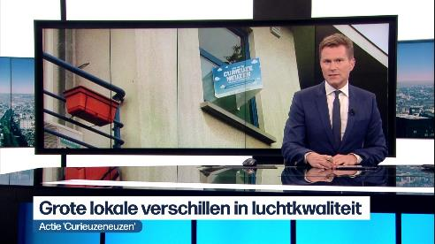
Communication of the results
Notes:
Individual results were communicated

Slide 21
More information

Slide 22
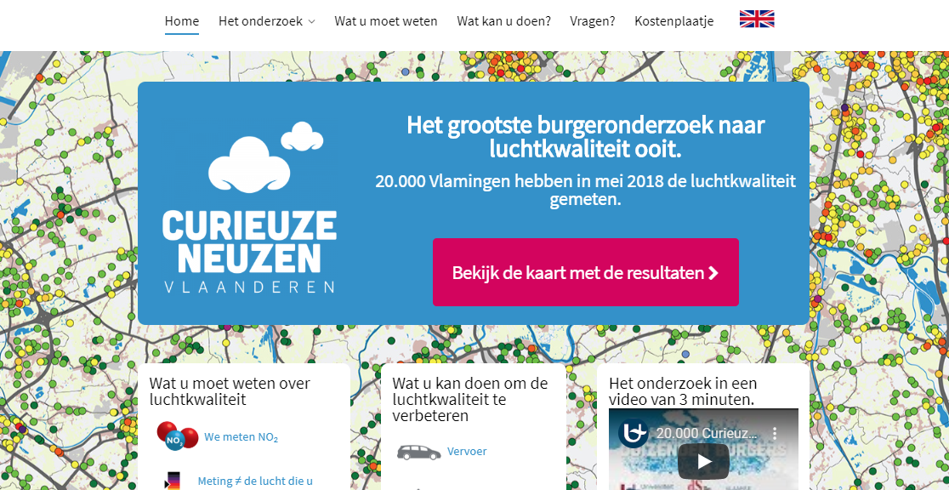
https://curieuzeneuzen.be/in-english/

Slide 23








Prof. dr. ir. Filip Meysman (UAntwerpen)

Slide 24
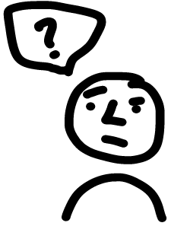





www.researchgate.net/profile/Evi_Dons
evi.dons@uhasselt.be

